Slide 1
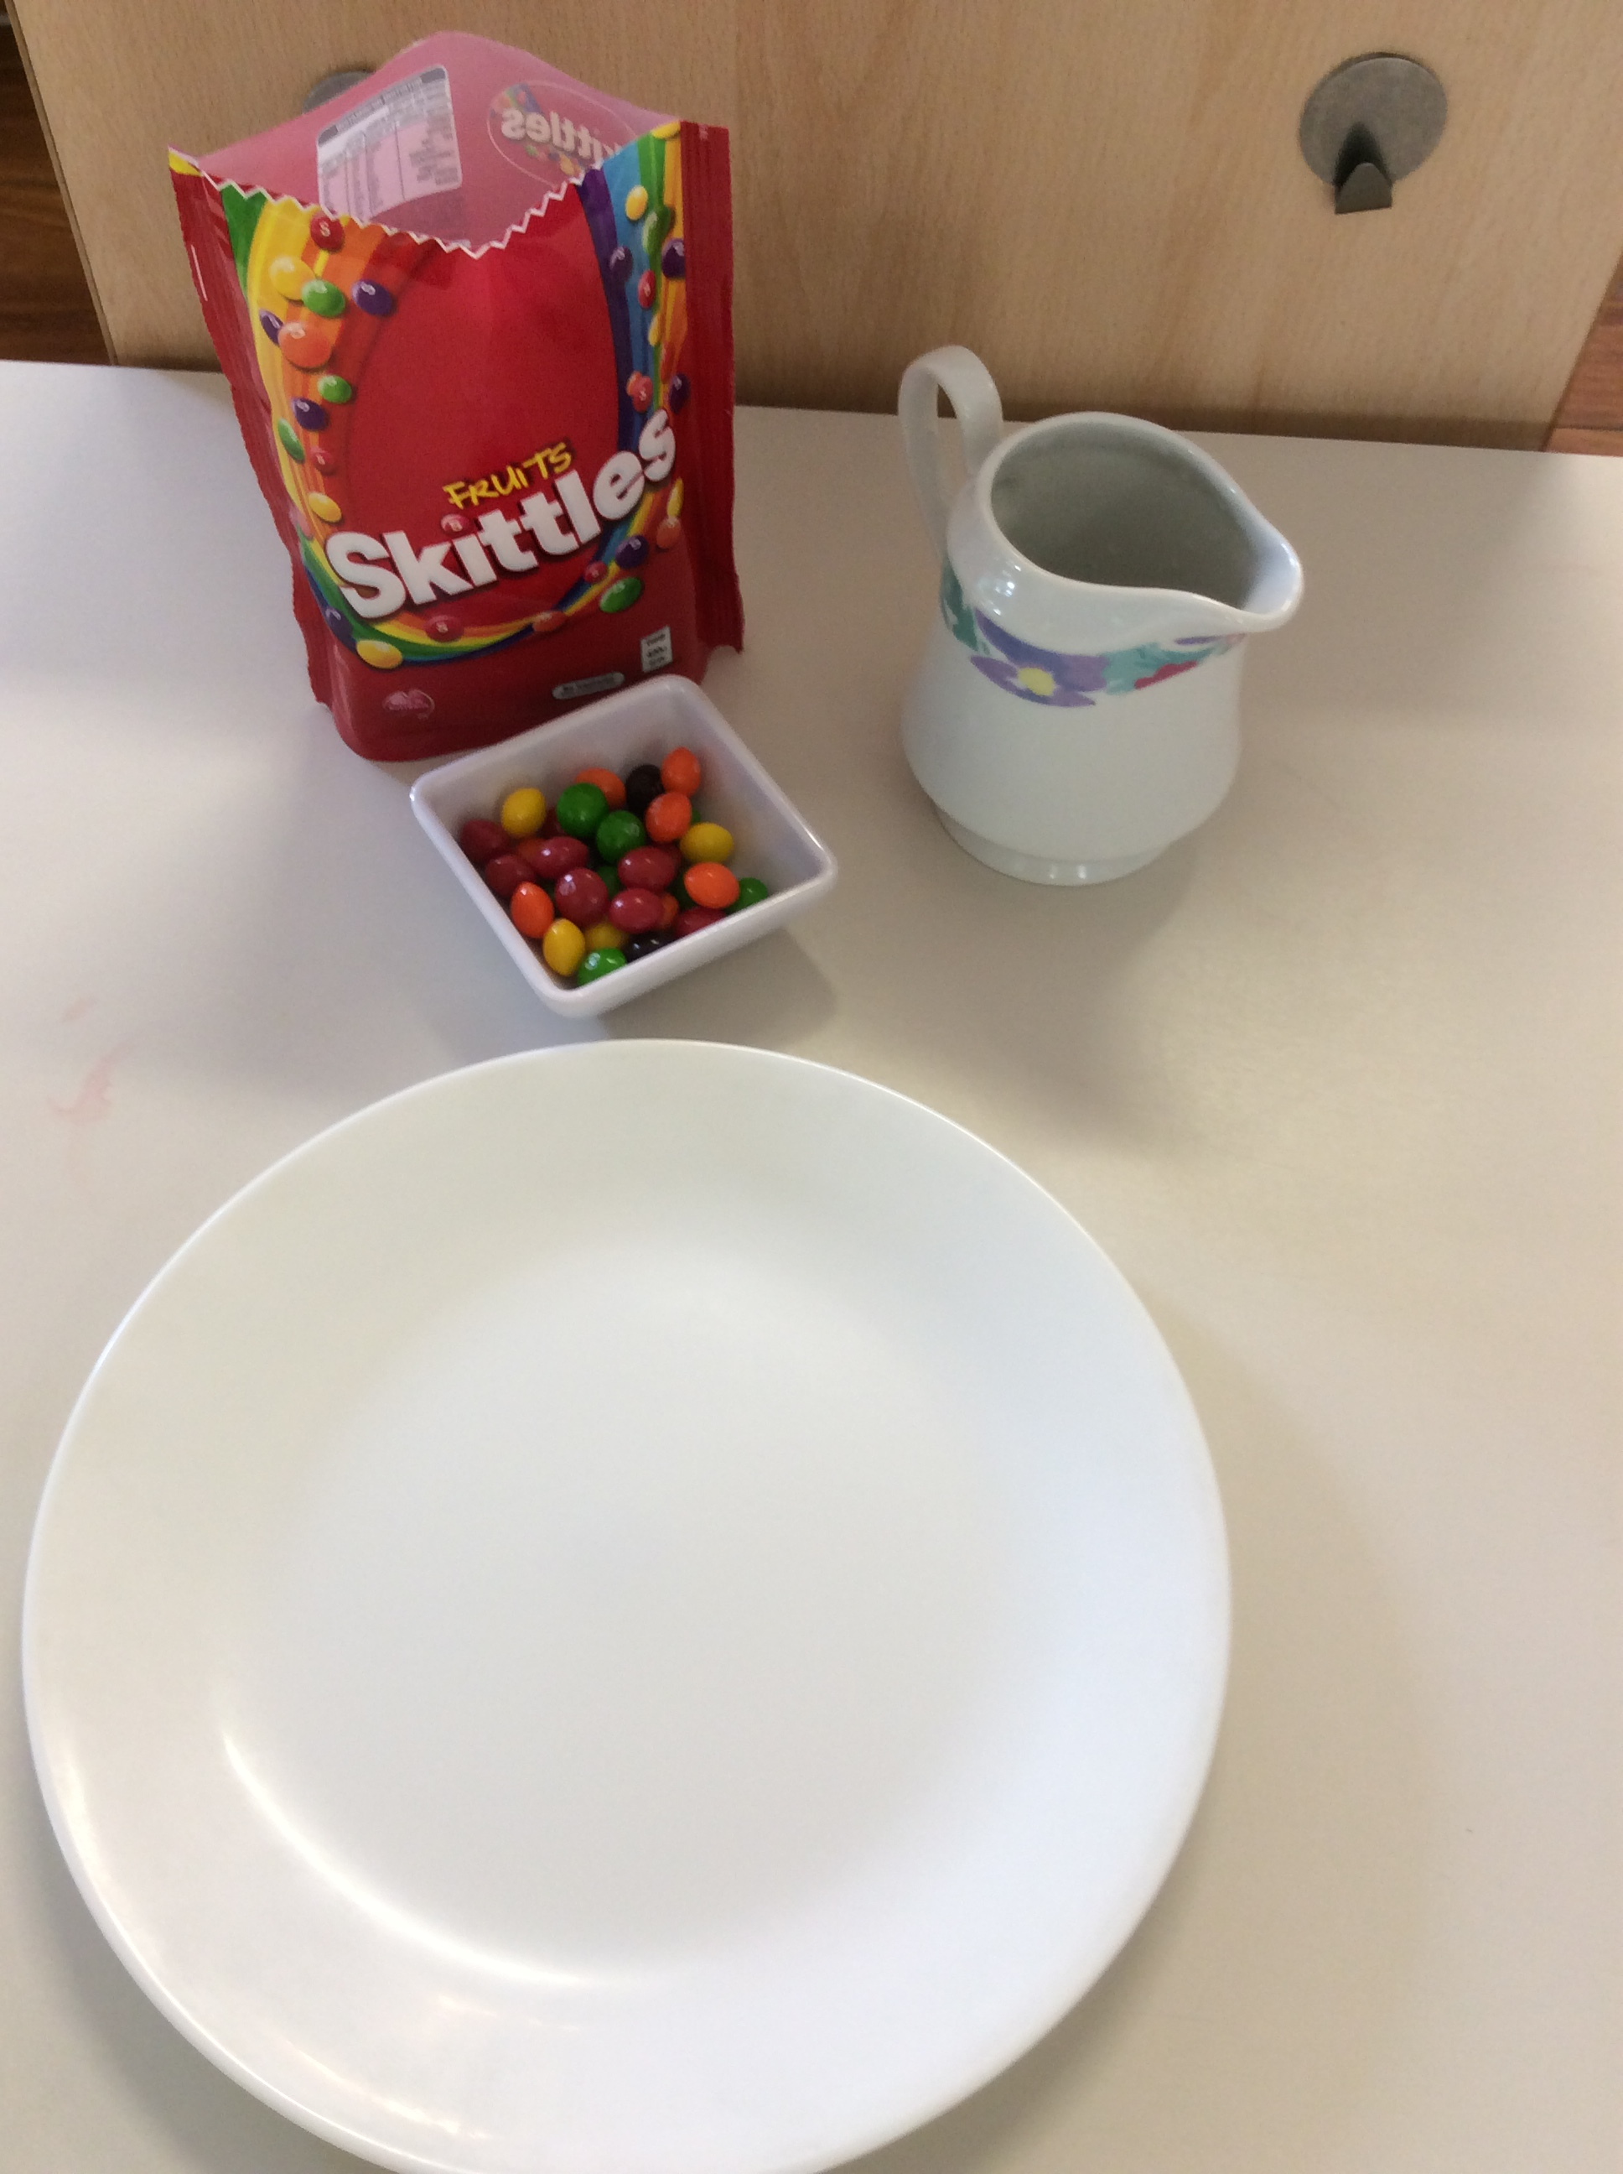
Skittles Experiment
You will need
1 pkt Skittles
¼ cup of warm water
White plate

Slide 2
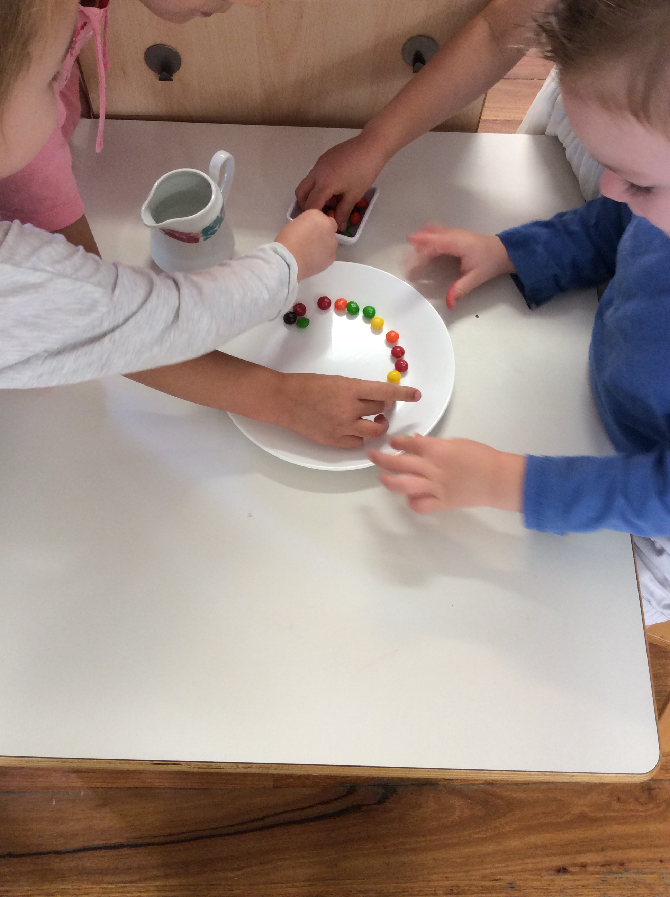
1.Arrange the skittles in a single row colored pattern around the edge of the plate.

Slide 3
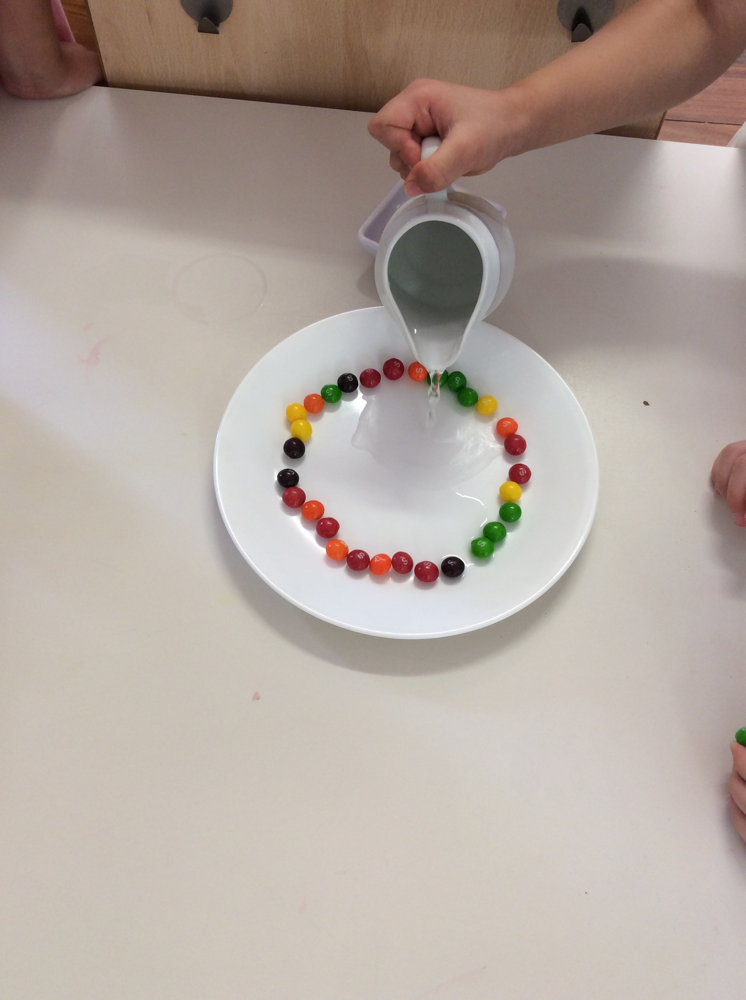
2.Pour over enough warm water to cover all the skittles and the plate itself.

Slide 4
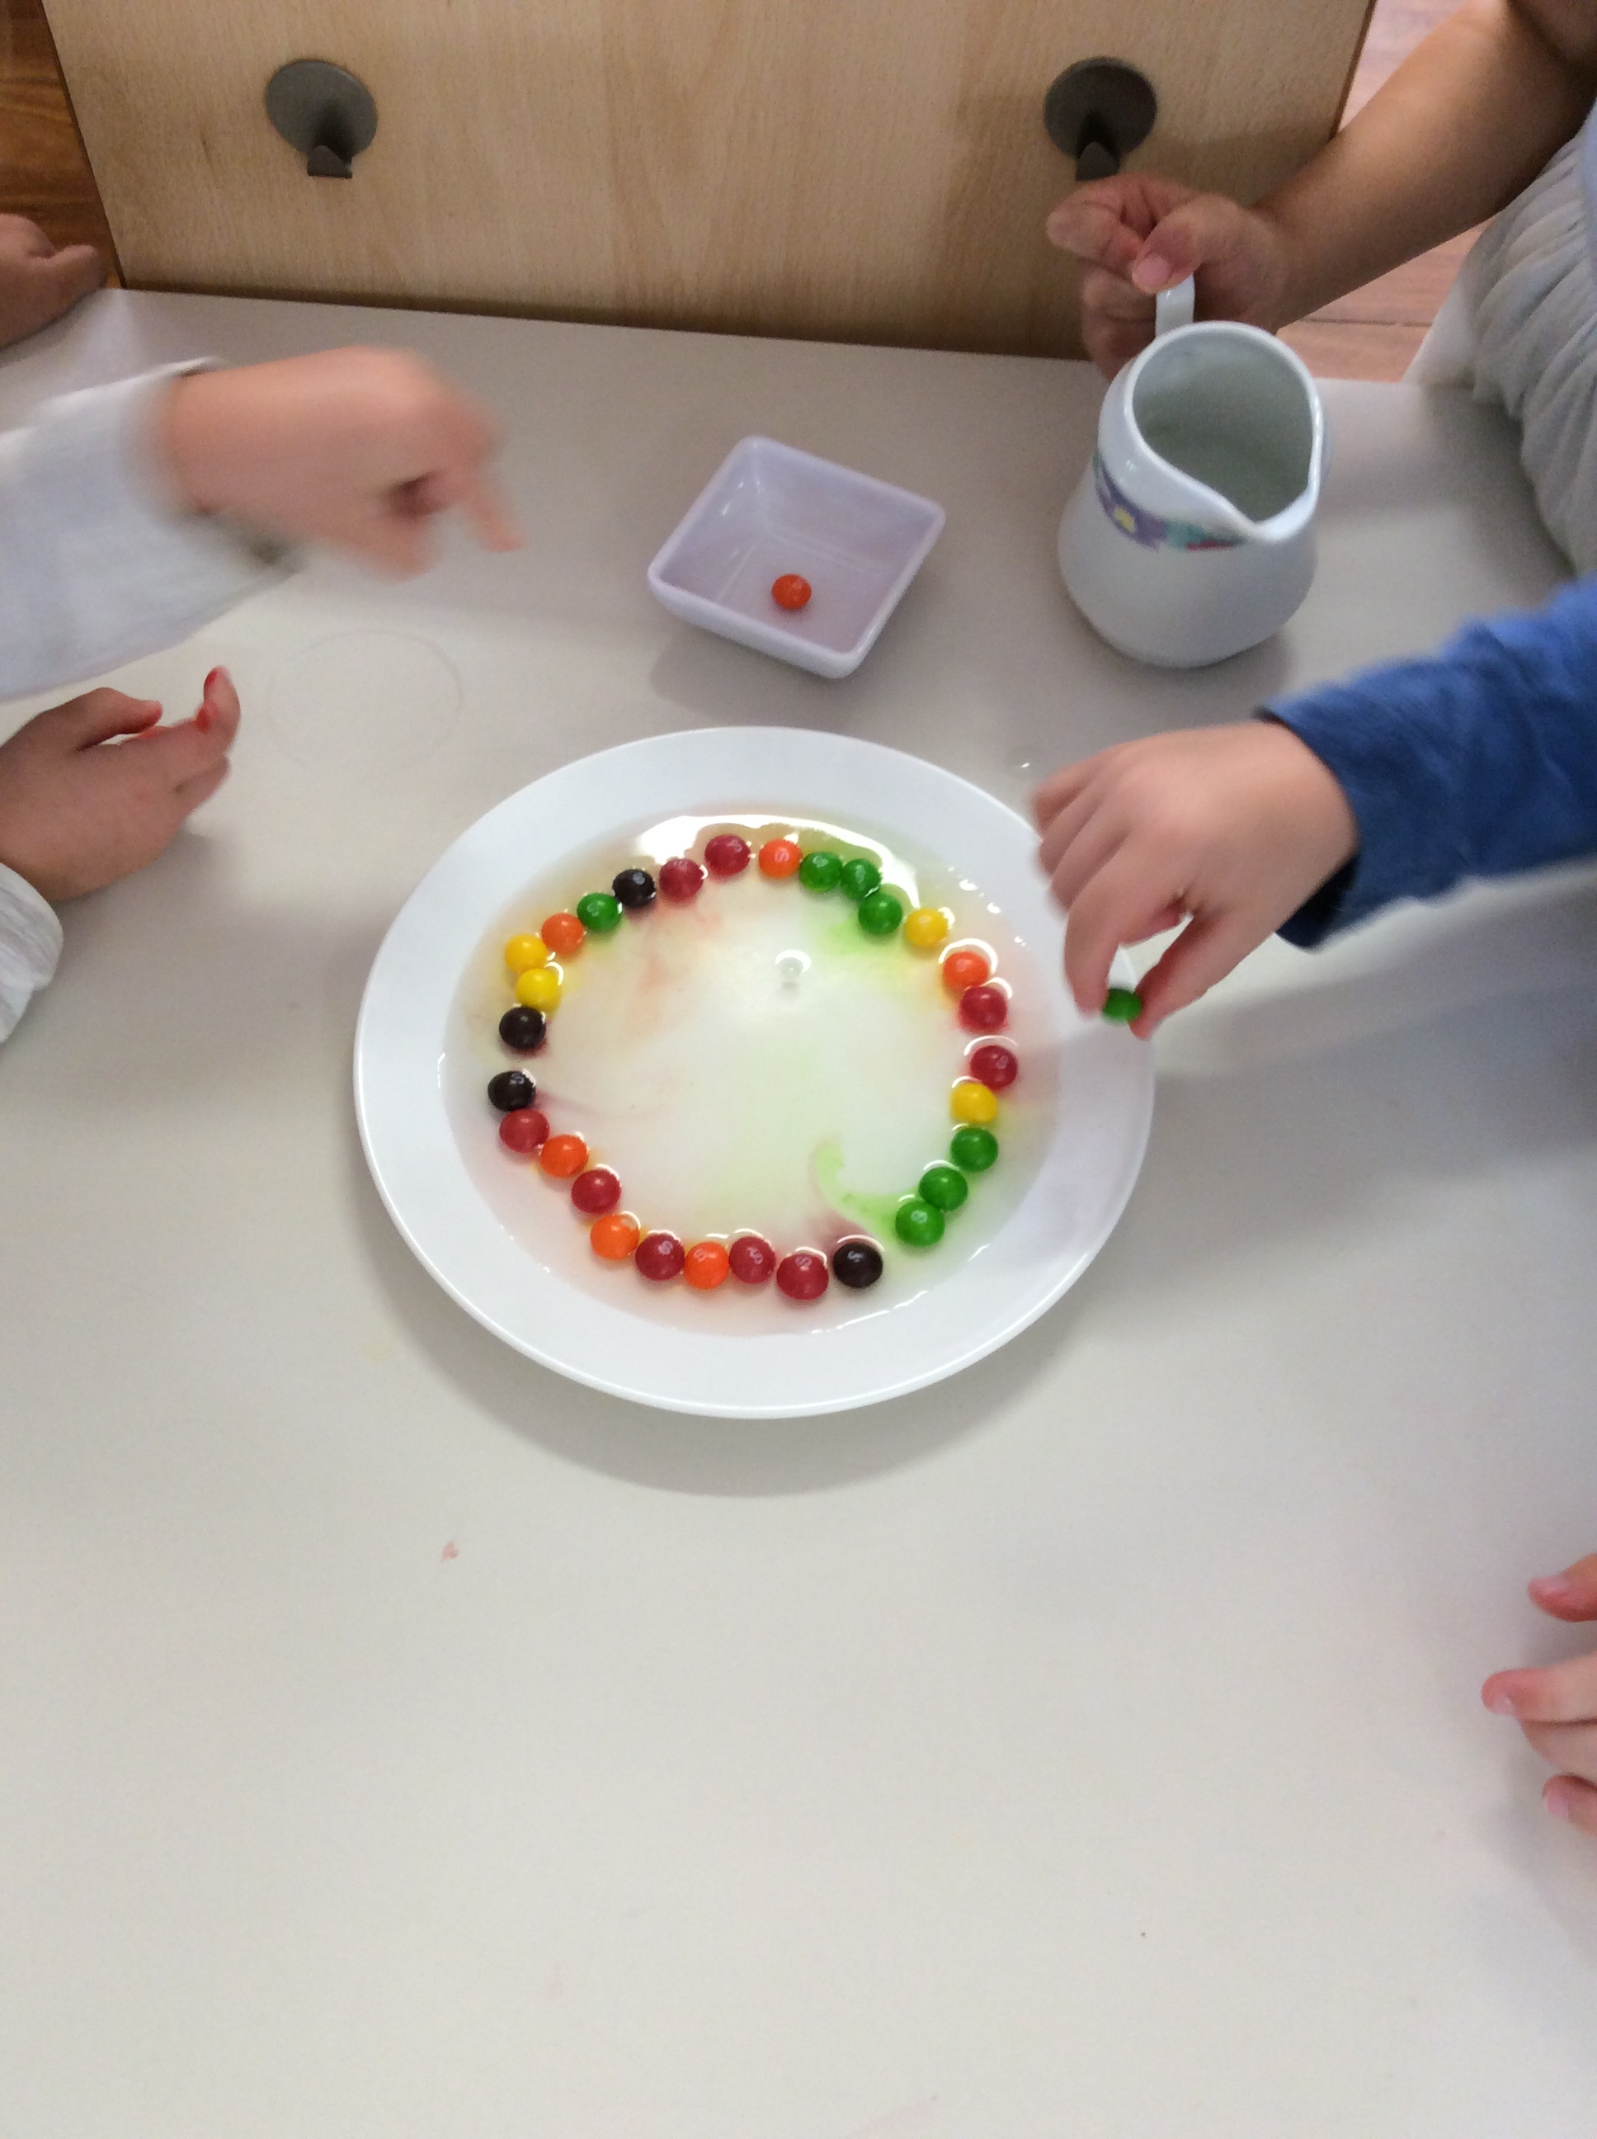
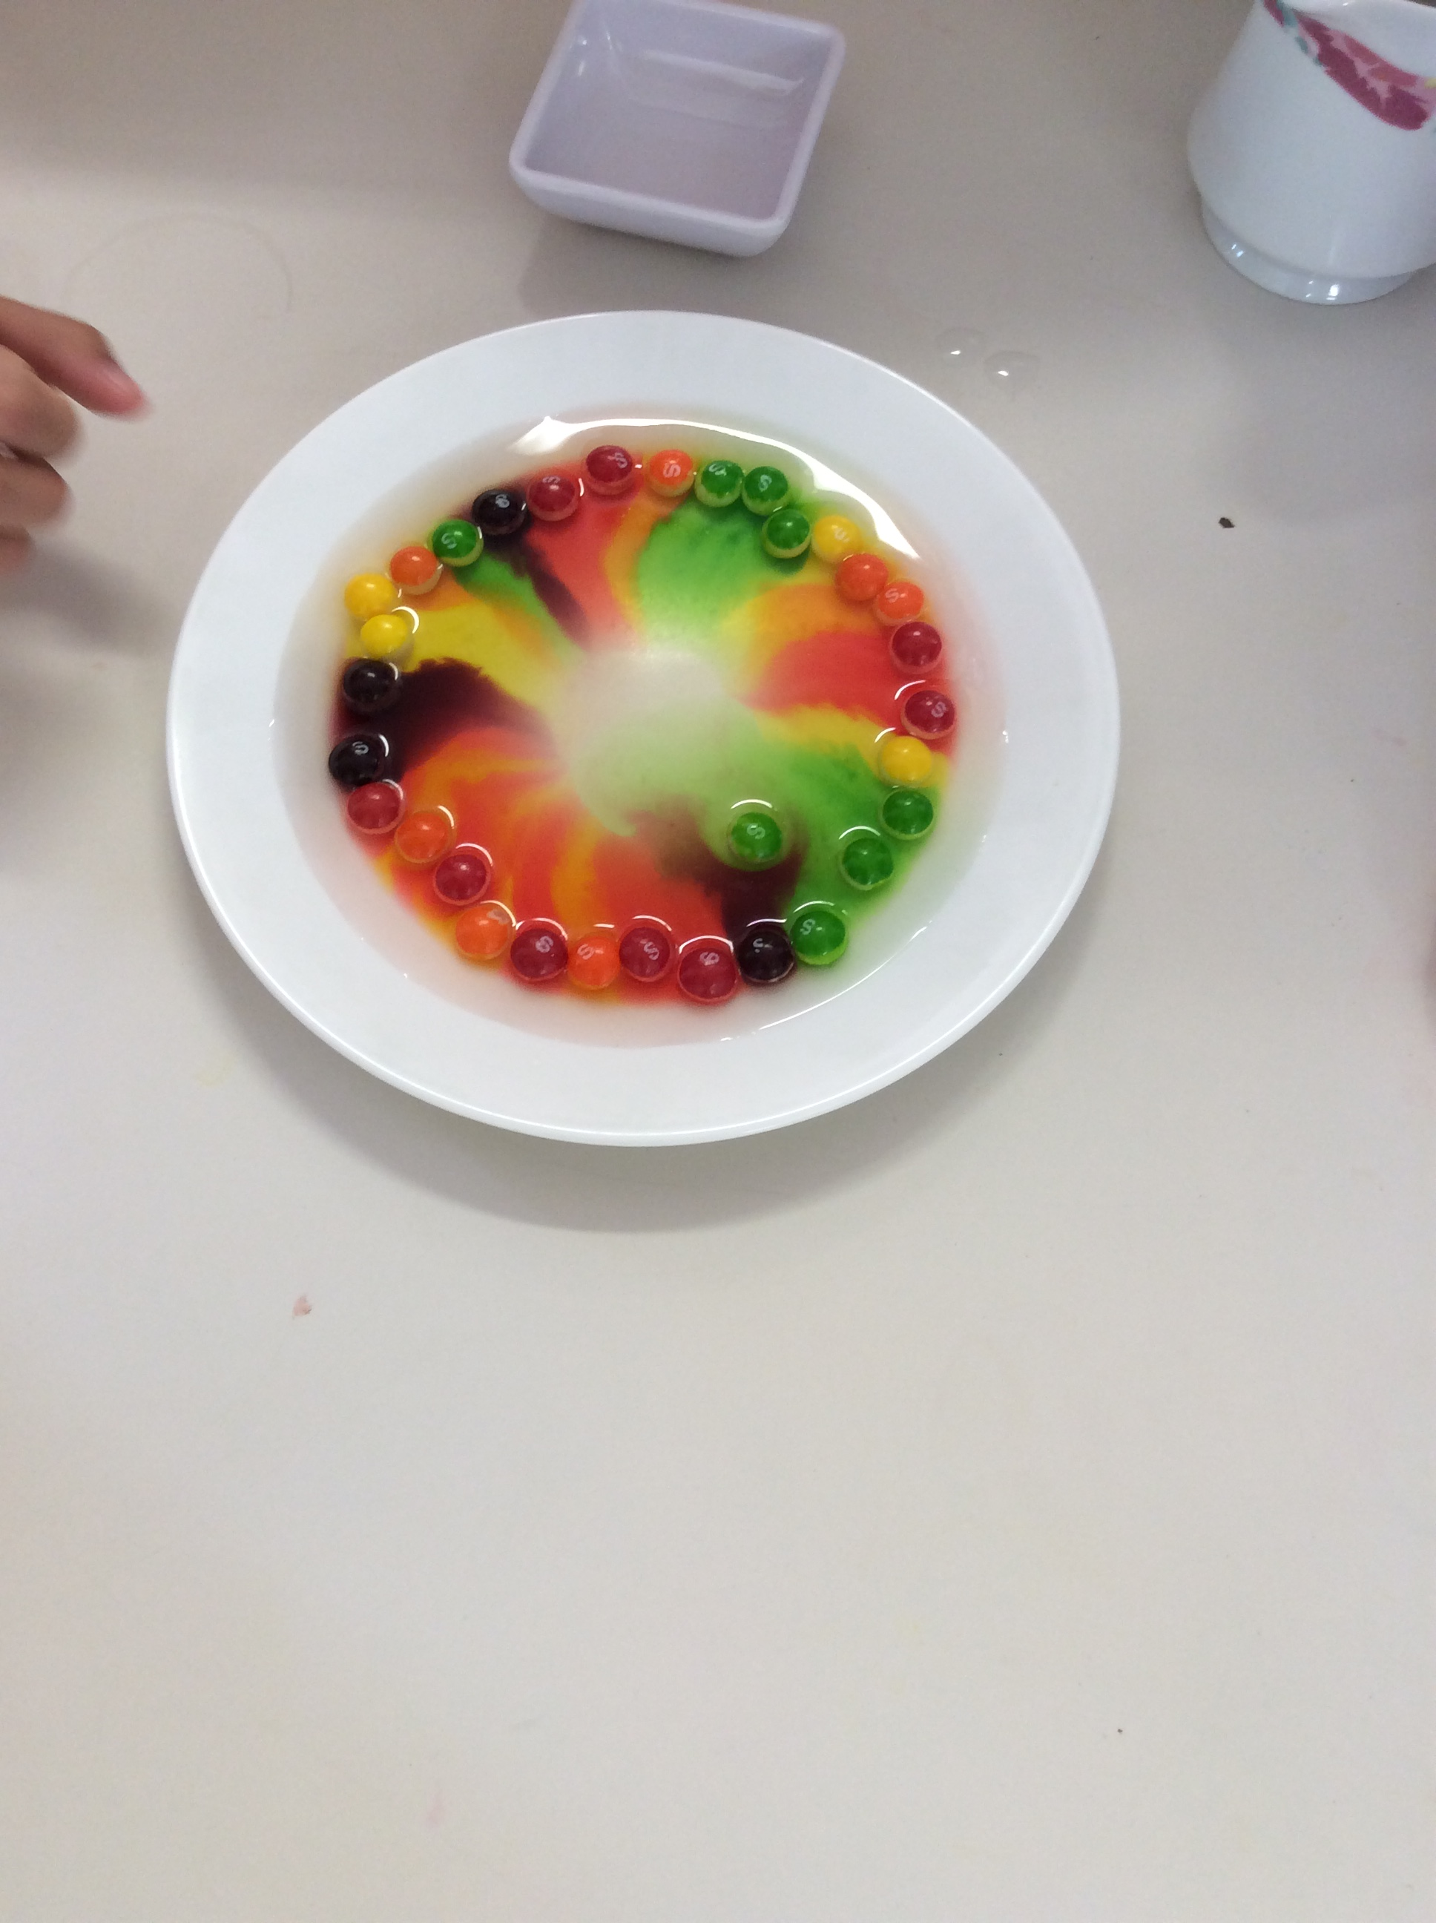
3.Watch and wait as a rainbow appears on the plate, the colors will move towards the middle and create a whirl of color.

