Slide 1
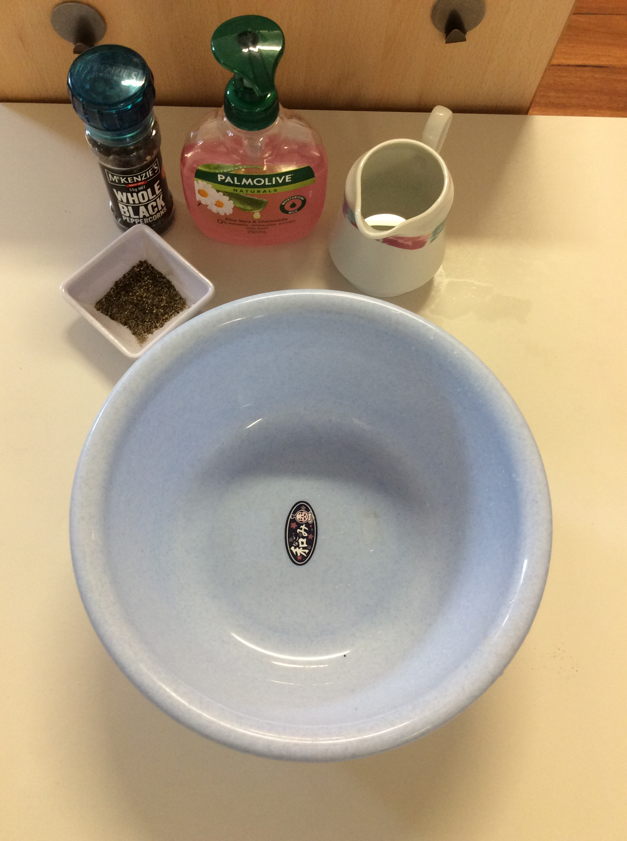
Pepper and Soap Experiment
Ingredients
Shallow bowl
Pepper
Dish soap

Slide 2
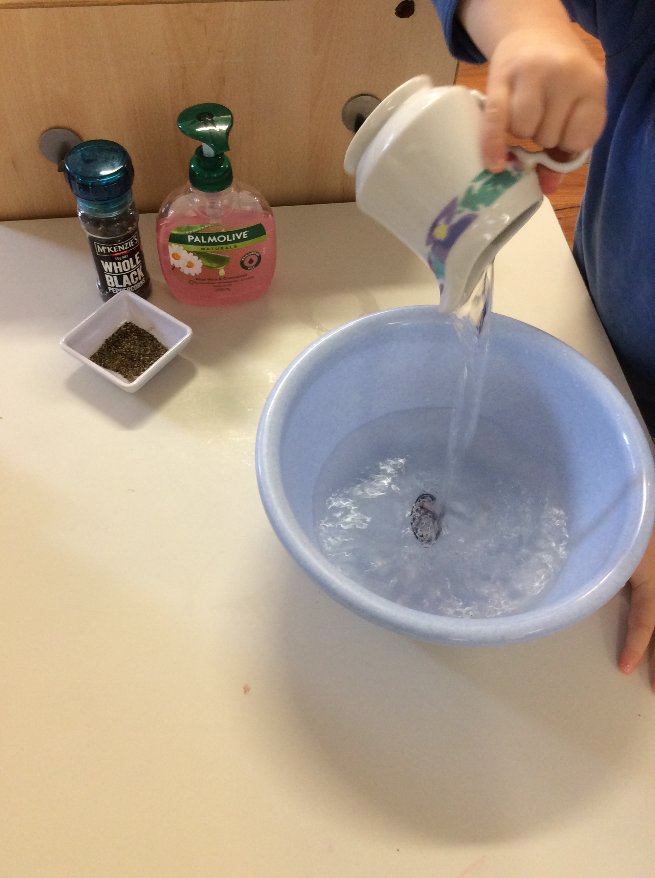
1. Fill the bowl with about an inch of water.

Slide 3
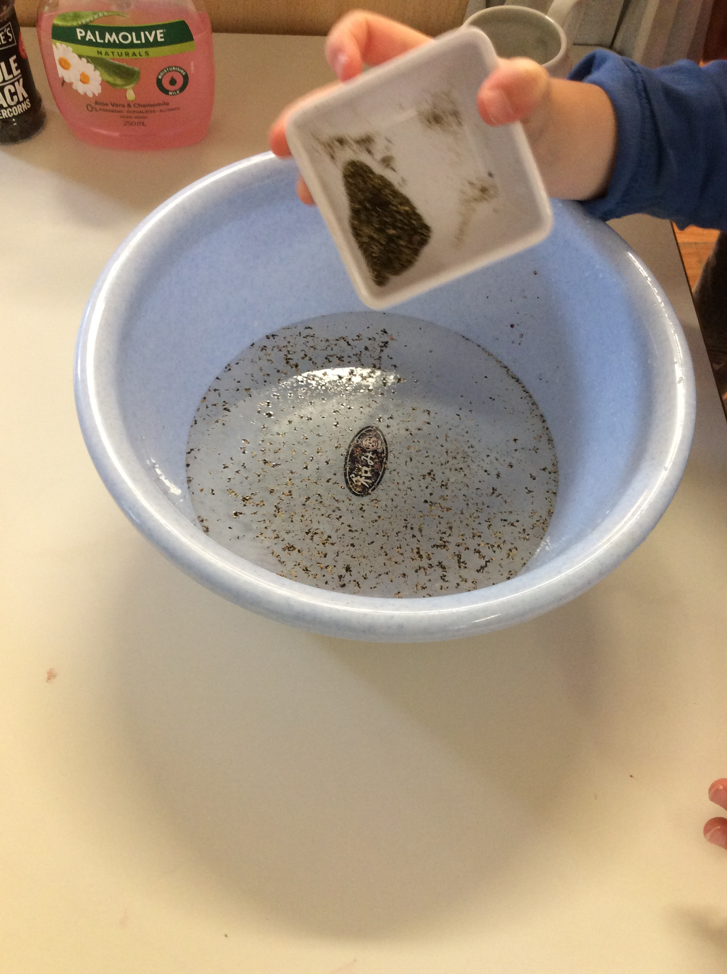
2. Sprinkle pepper evenly across the surface.

Slide 4
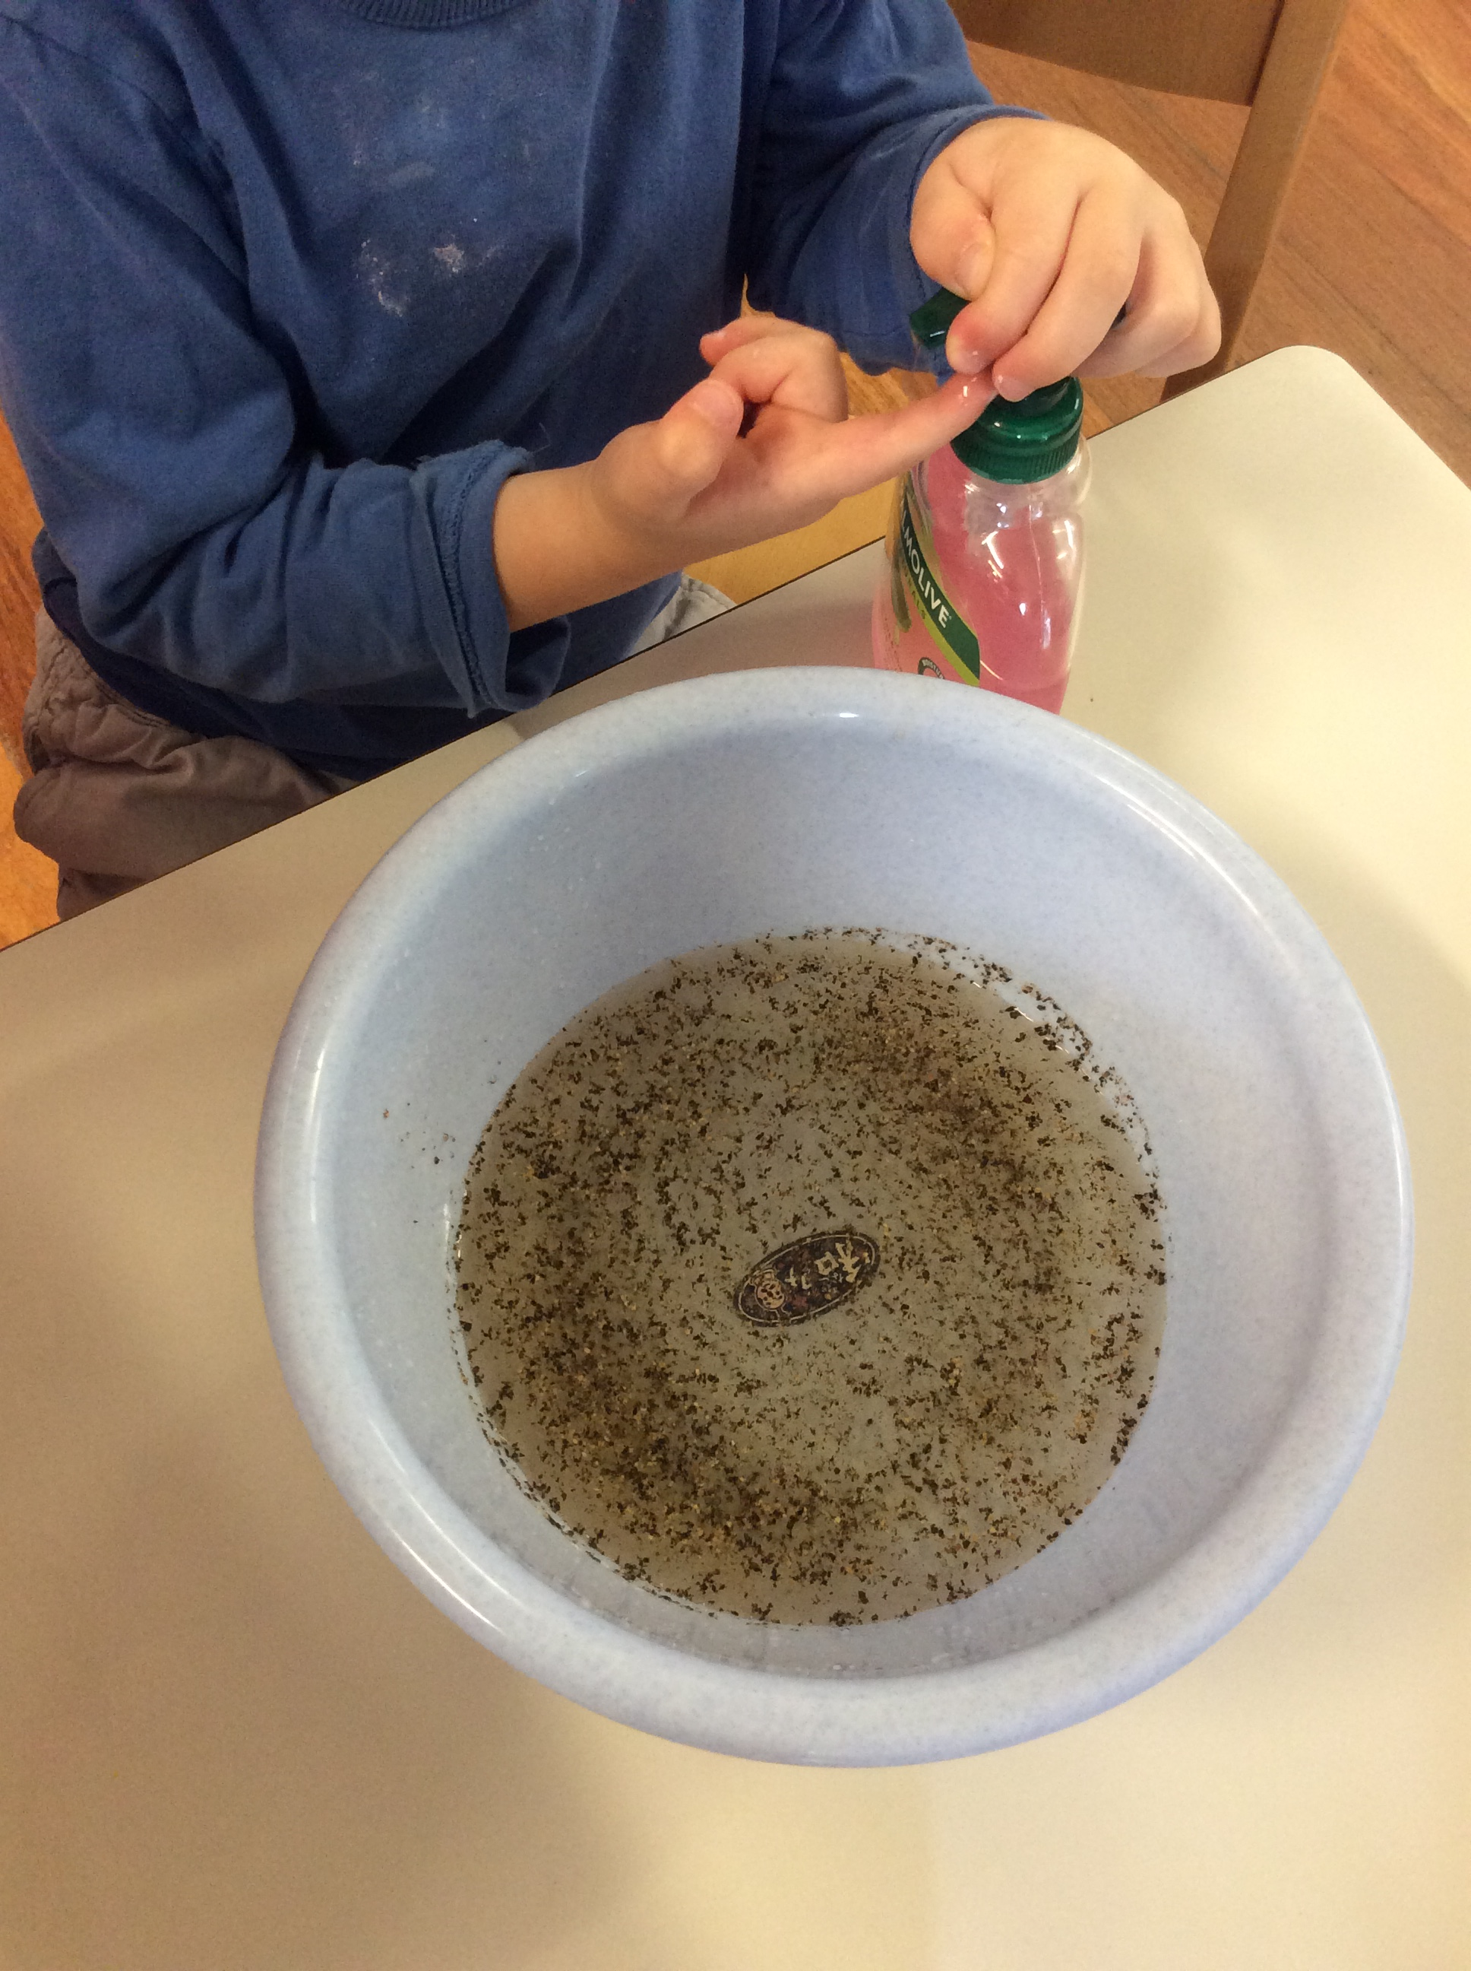
3.Squeeze a tiny bubble of dish soap on the tip of your finger.

Slide 5

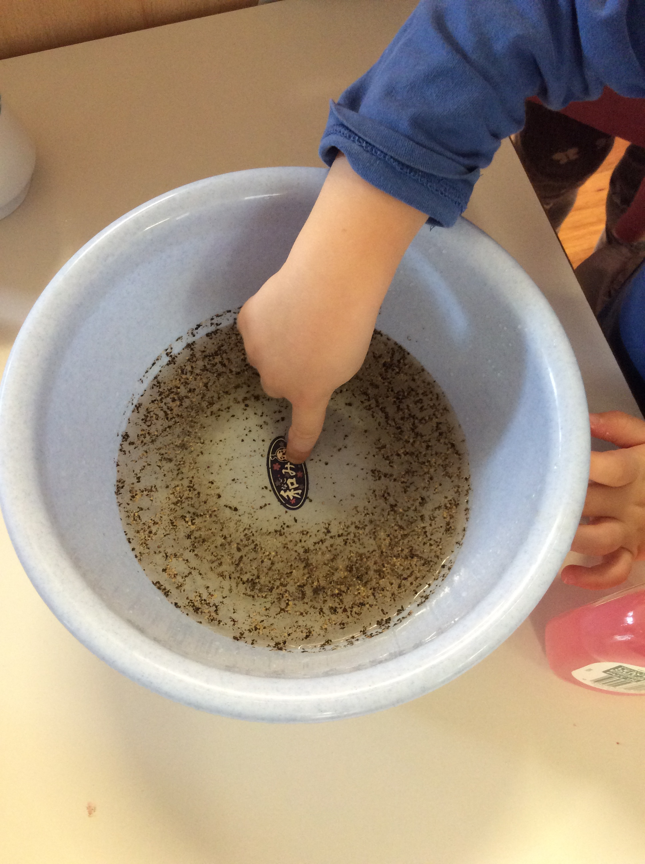
4.Touch the finger to the bottom of the bowl.

Slide 6
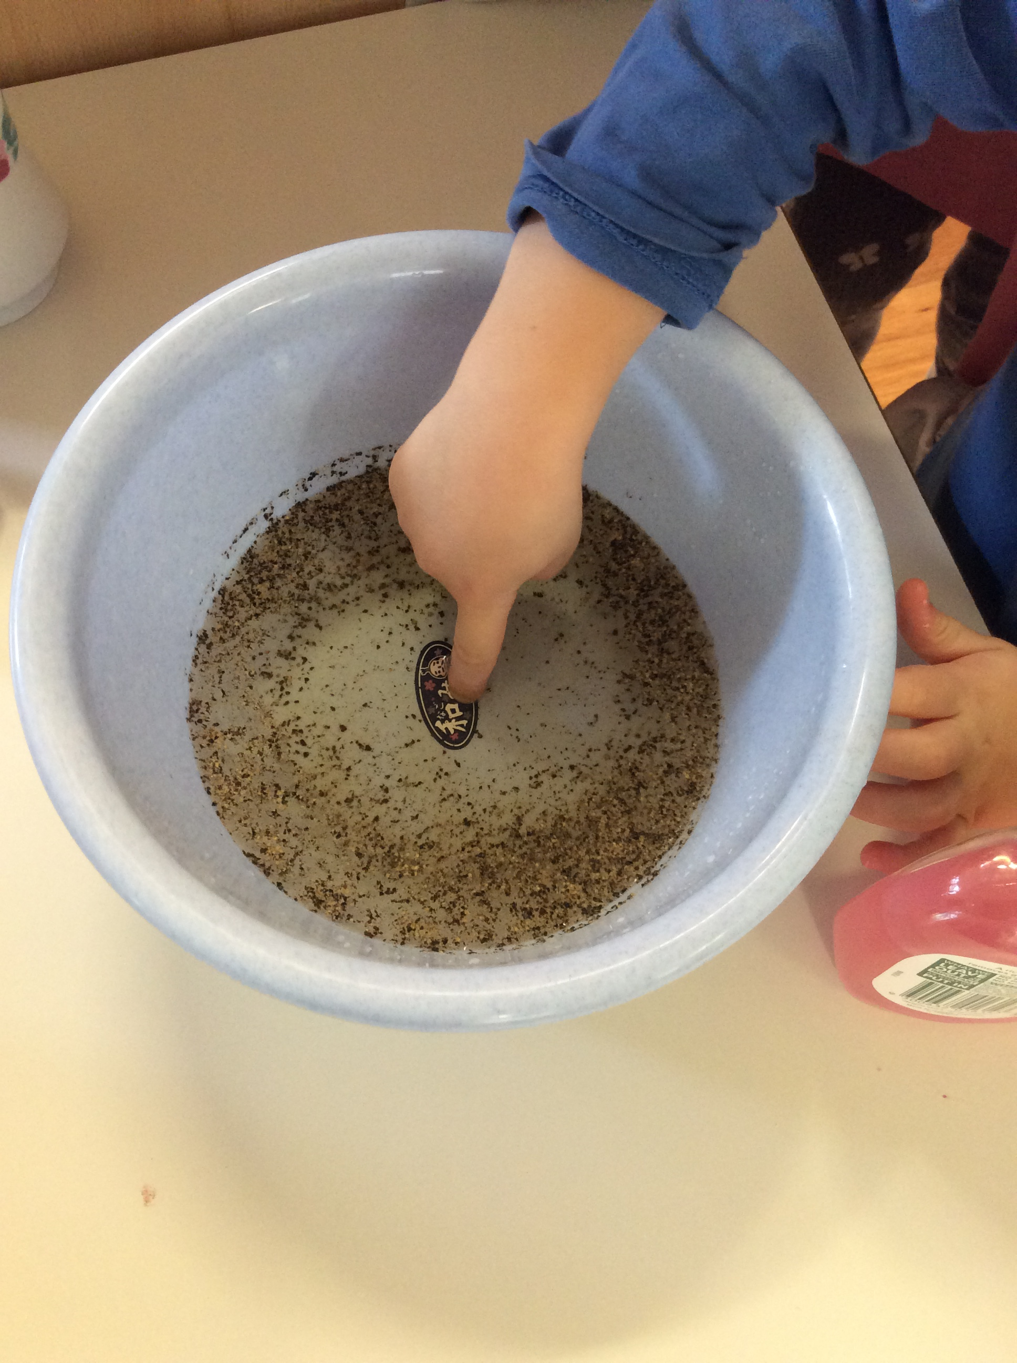
5.Most of the pepper flakes have darted to the sides of the bowl. It looked like the soap was chasing the pepper flakes away.

