Slide 1
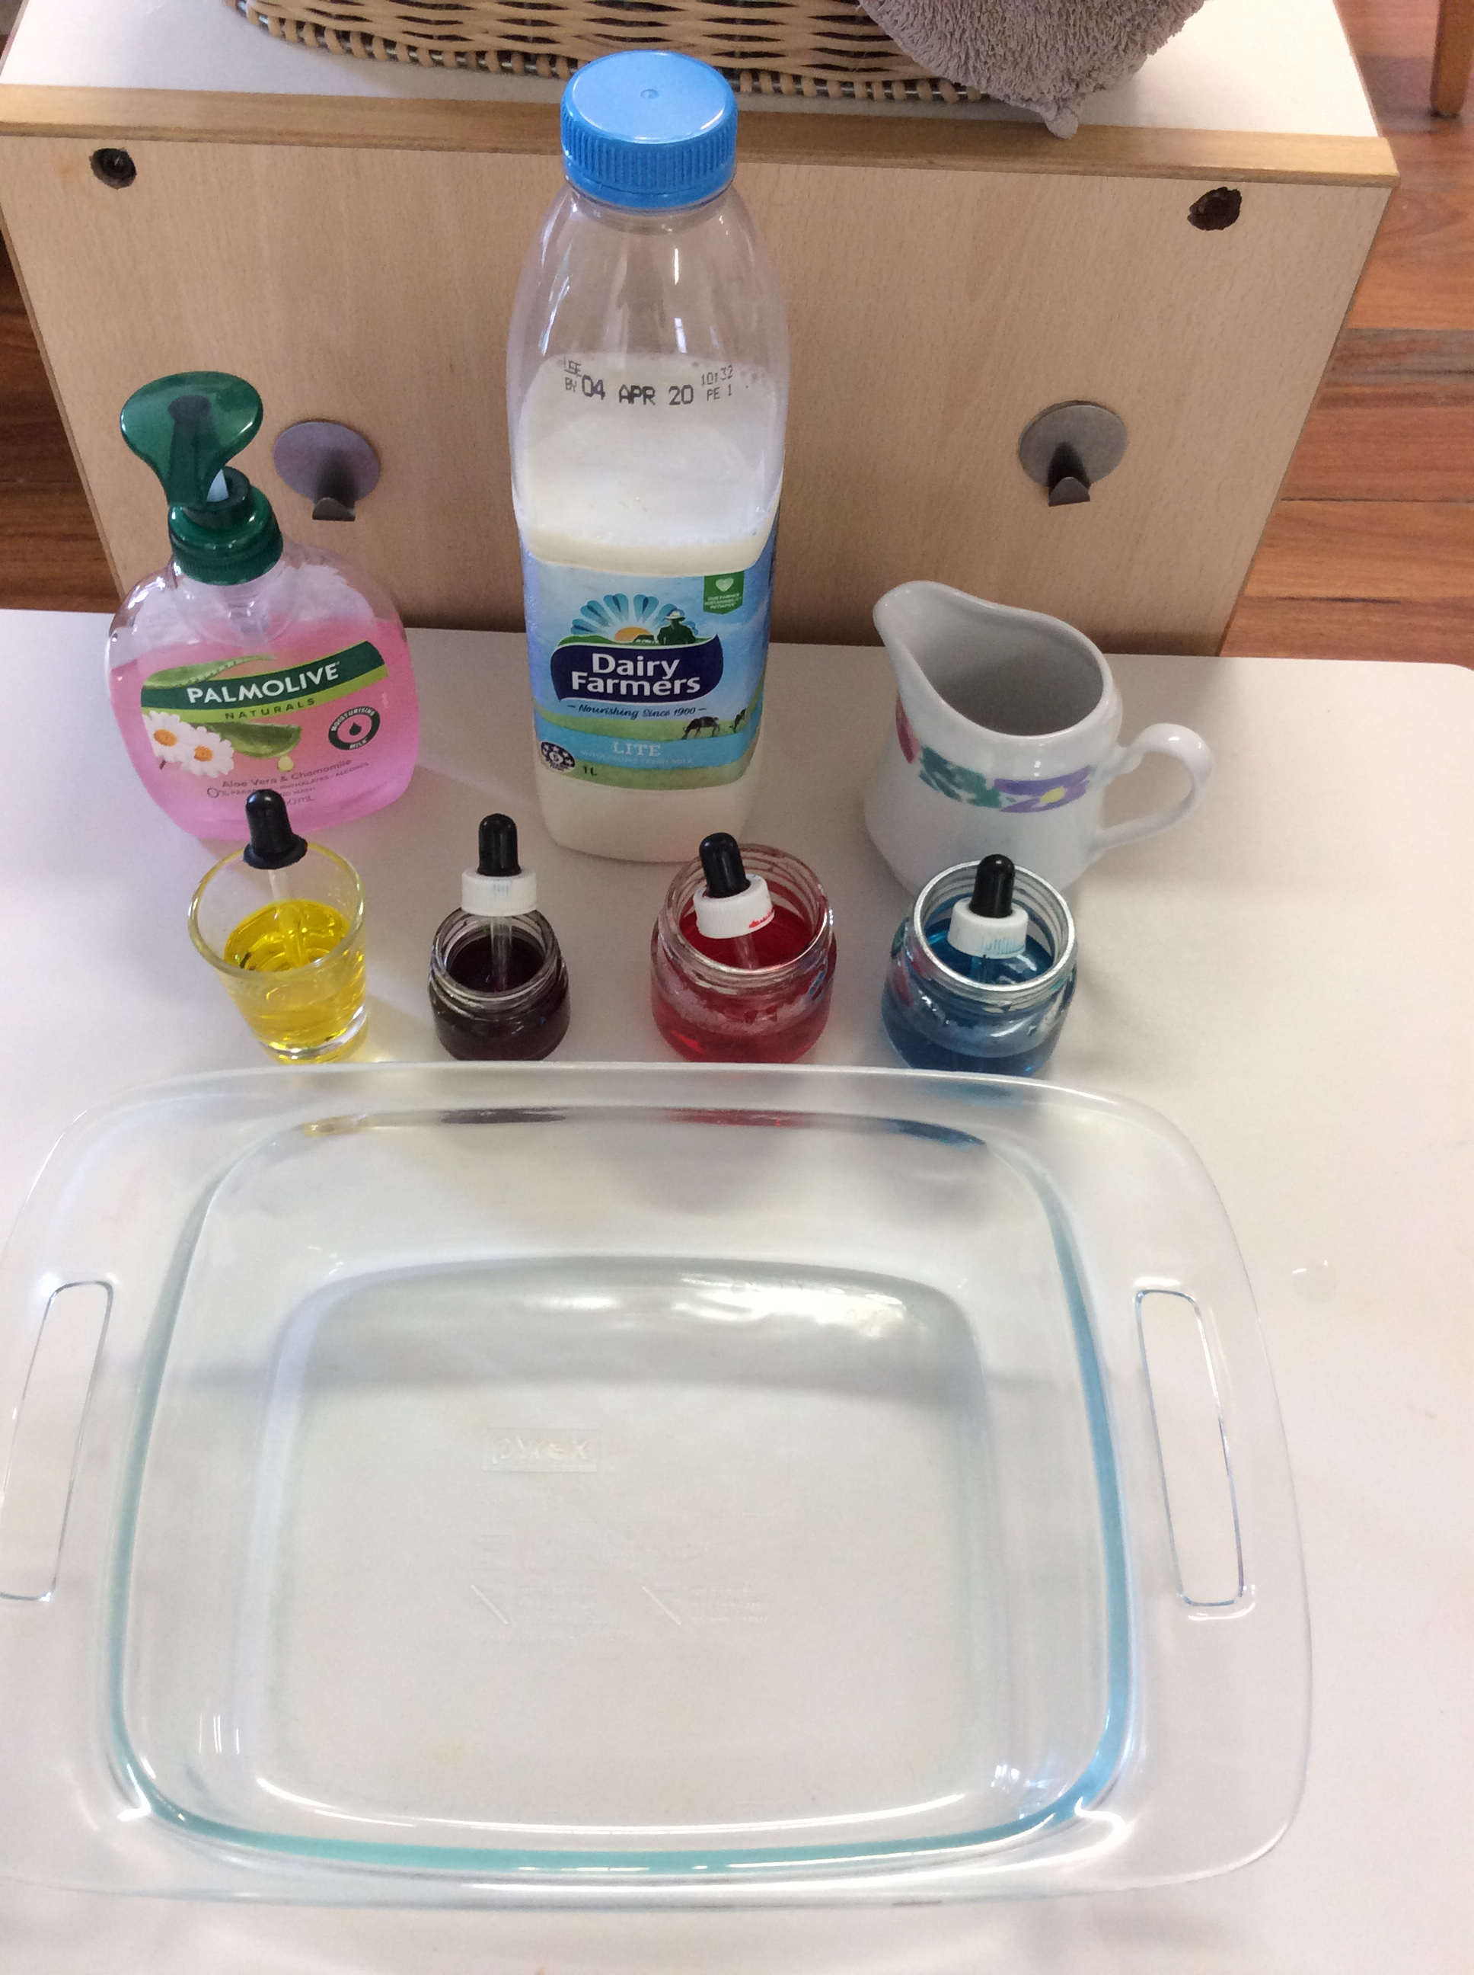
Color changing Milk Experiment
What will you need
A shallow dish
Some Milk
Food coloring
Liquid dish soap

Slide 2
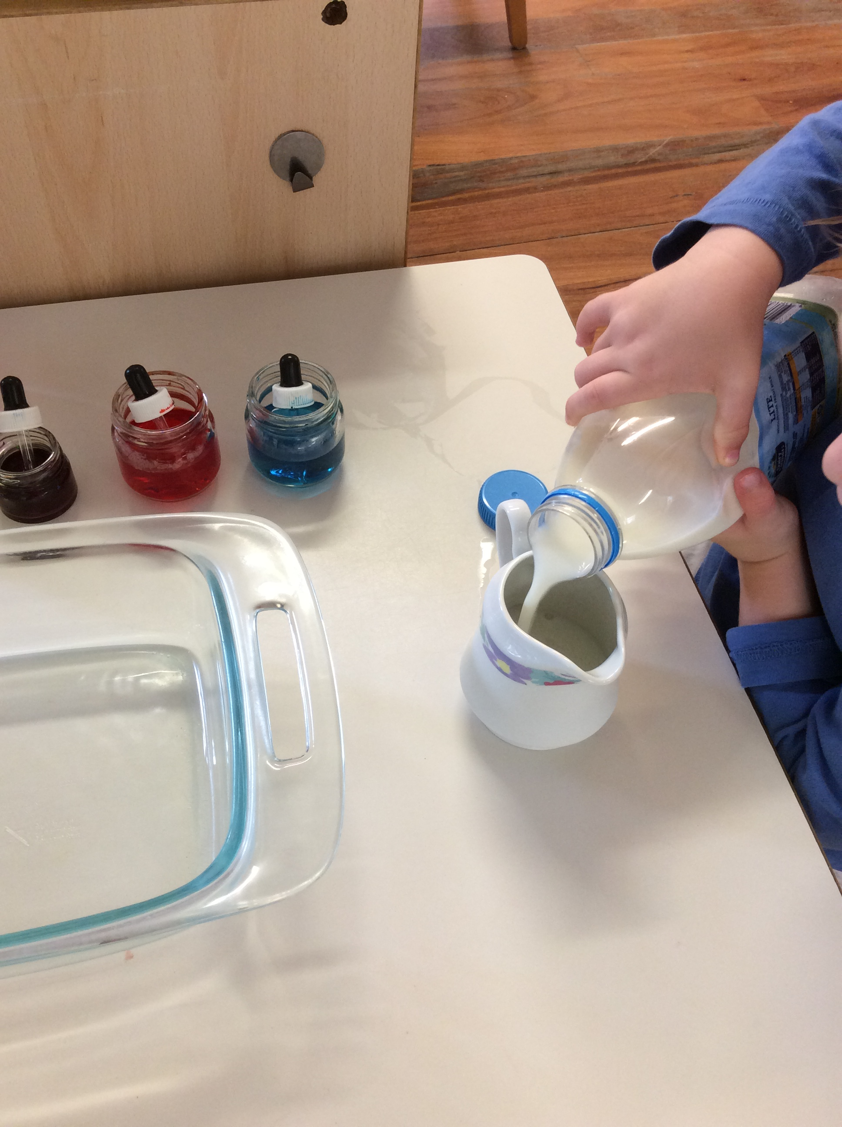
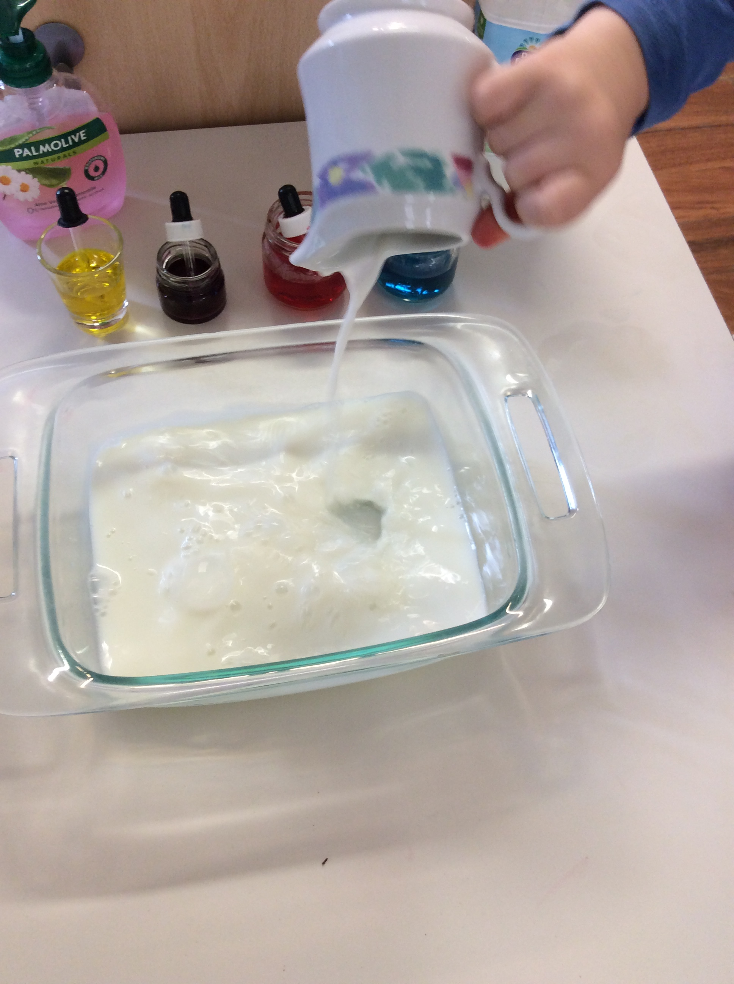
1. Let the milk sit out for a while as it works much better than cold milk. Pour a layer of Milk in the dish about 1 cm deep.

Slide 3
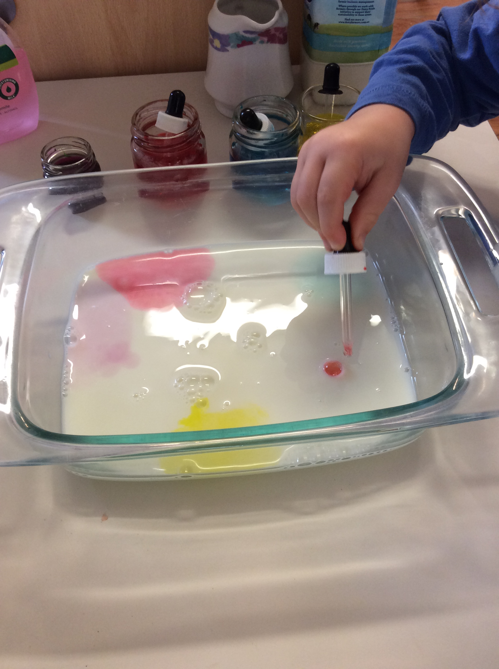
2. Put drop of each of the four food colors onto the surface of the milk, widely separated and not in the center of the dish.

Slide 4
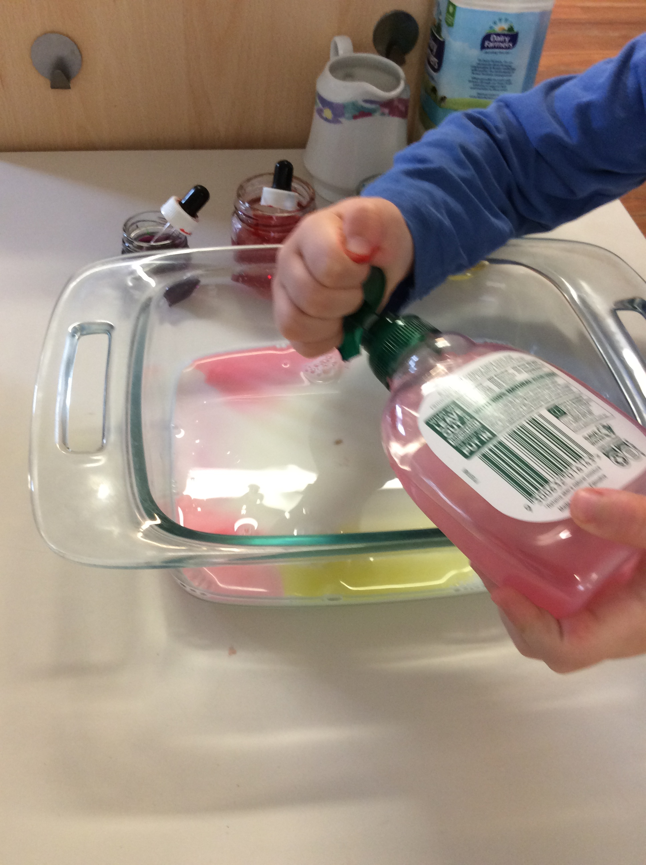
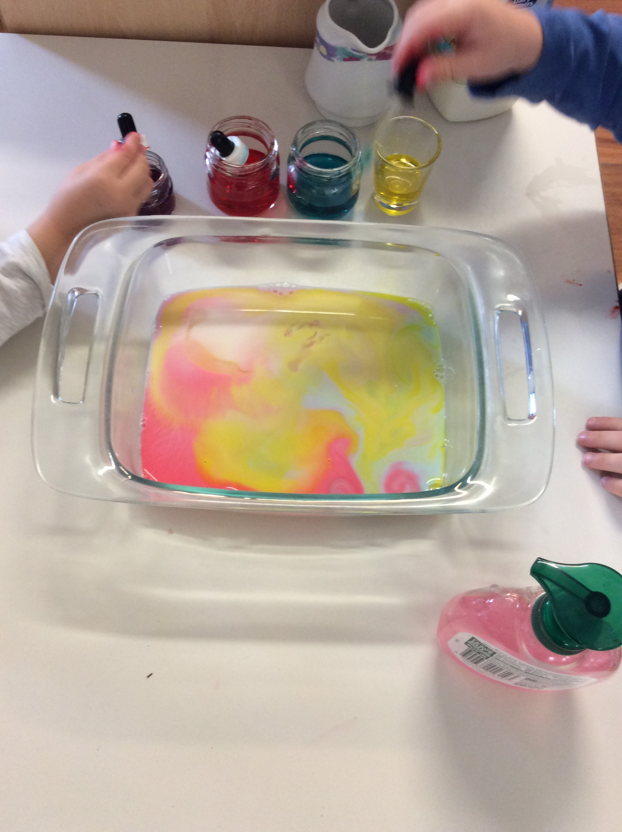
3.Drop one drop of dish soap onto the surface of the milk in the center of the dish. And get ready to watch what happens.

