Slide 1
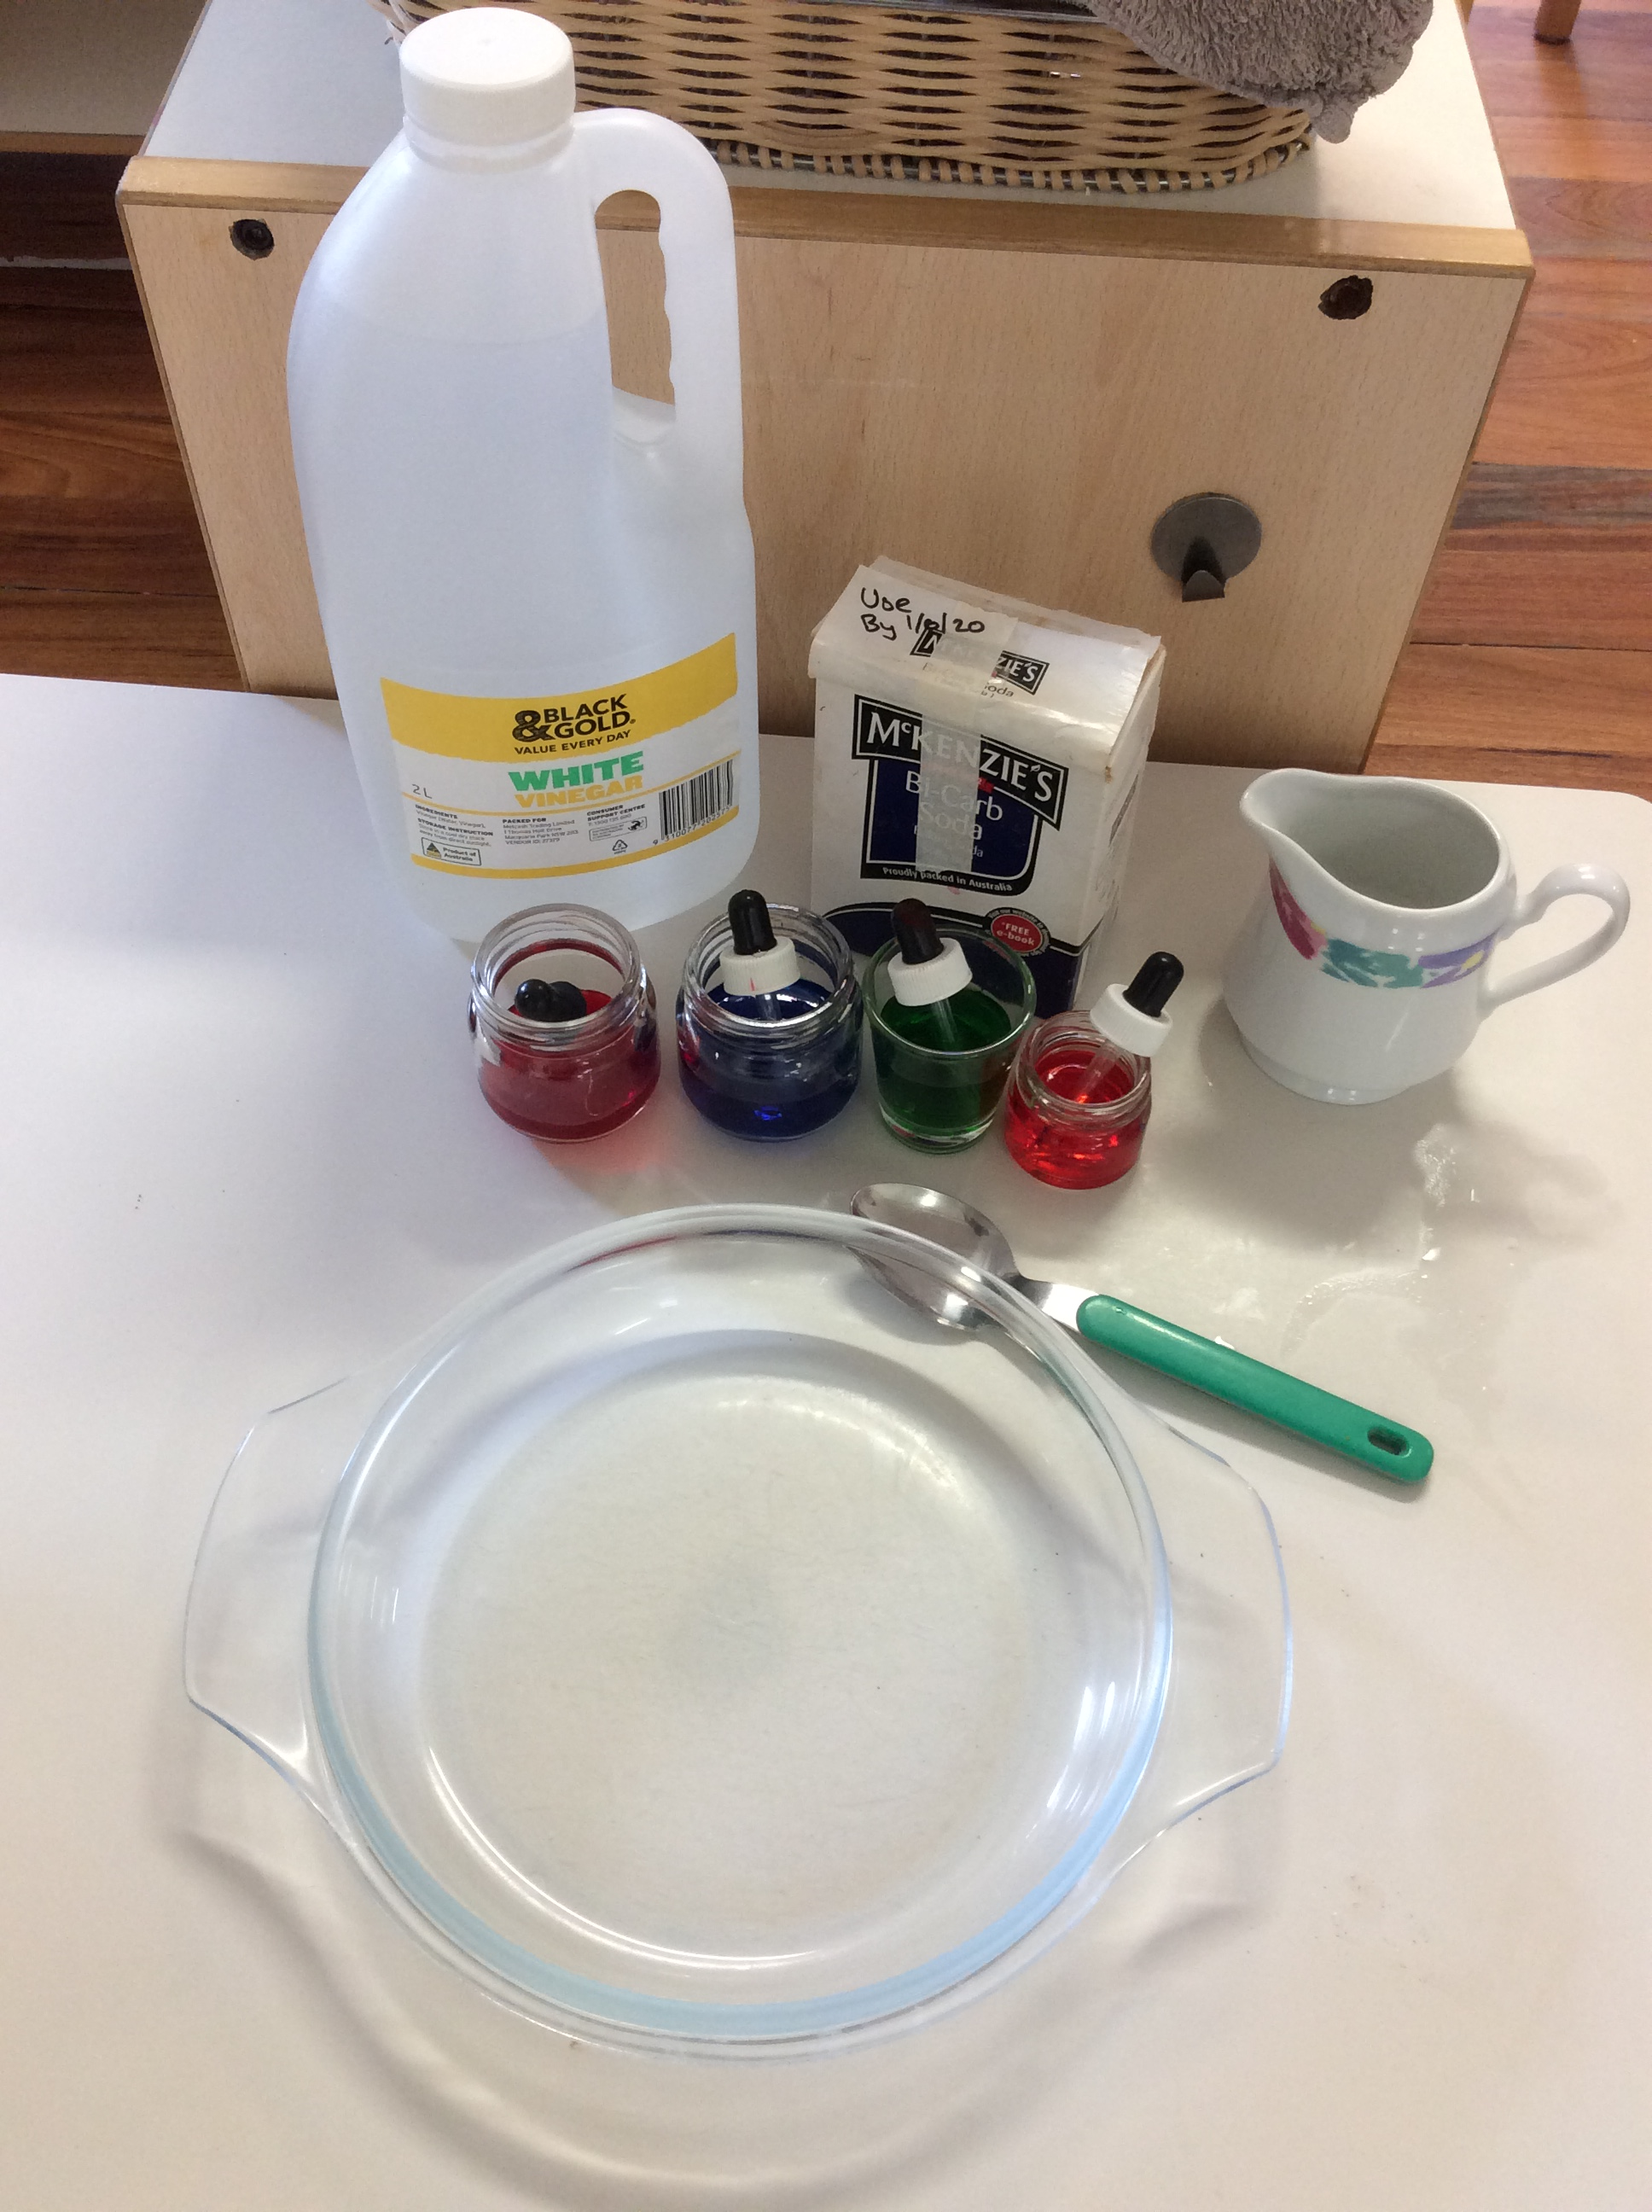
Baking Soda and Vinegar Experiment
Ingredients:
-Baking Soda
-Vinegar
-Eye Dropper
-Food Coloring

Slide 2
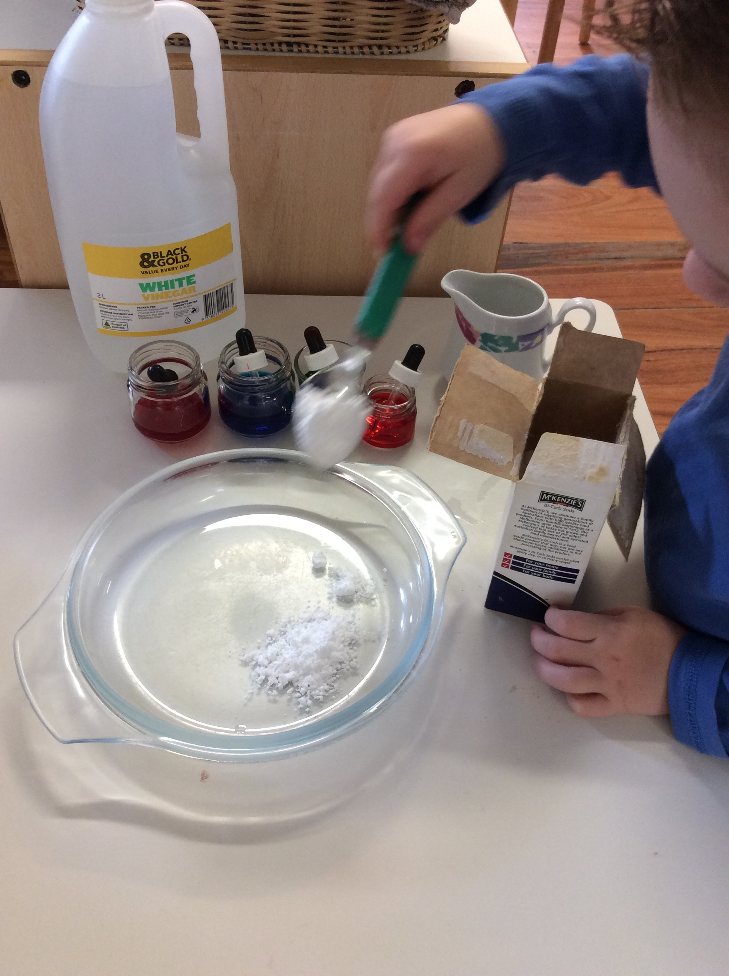
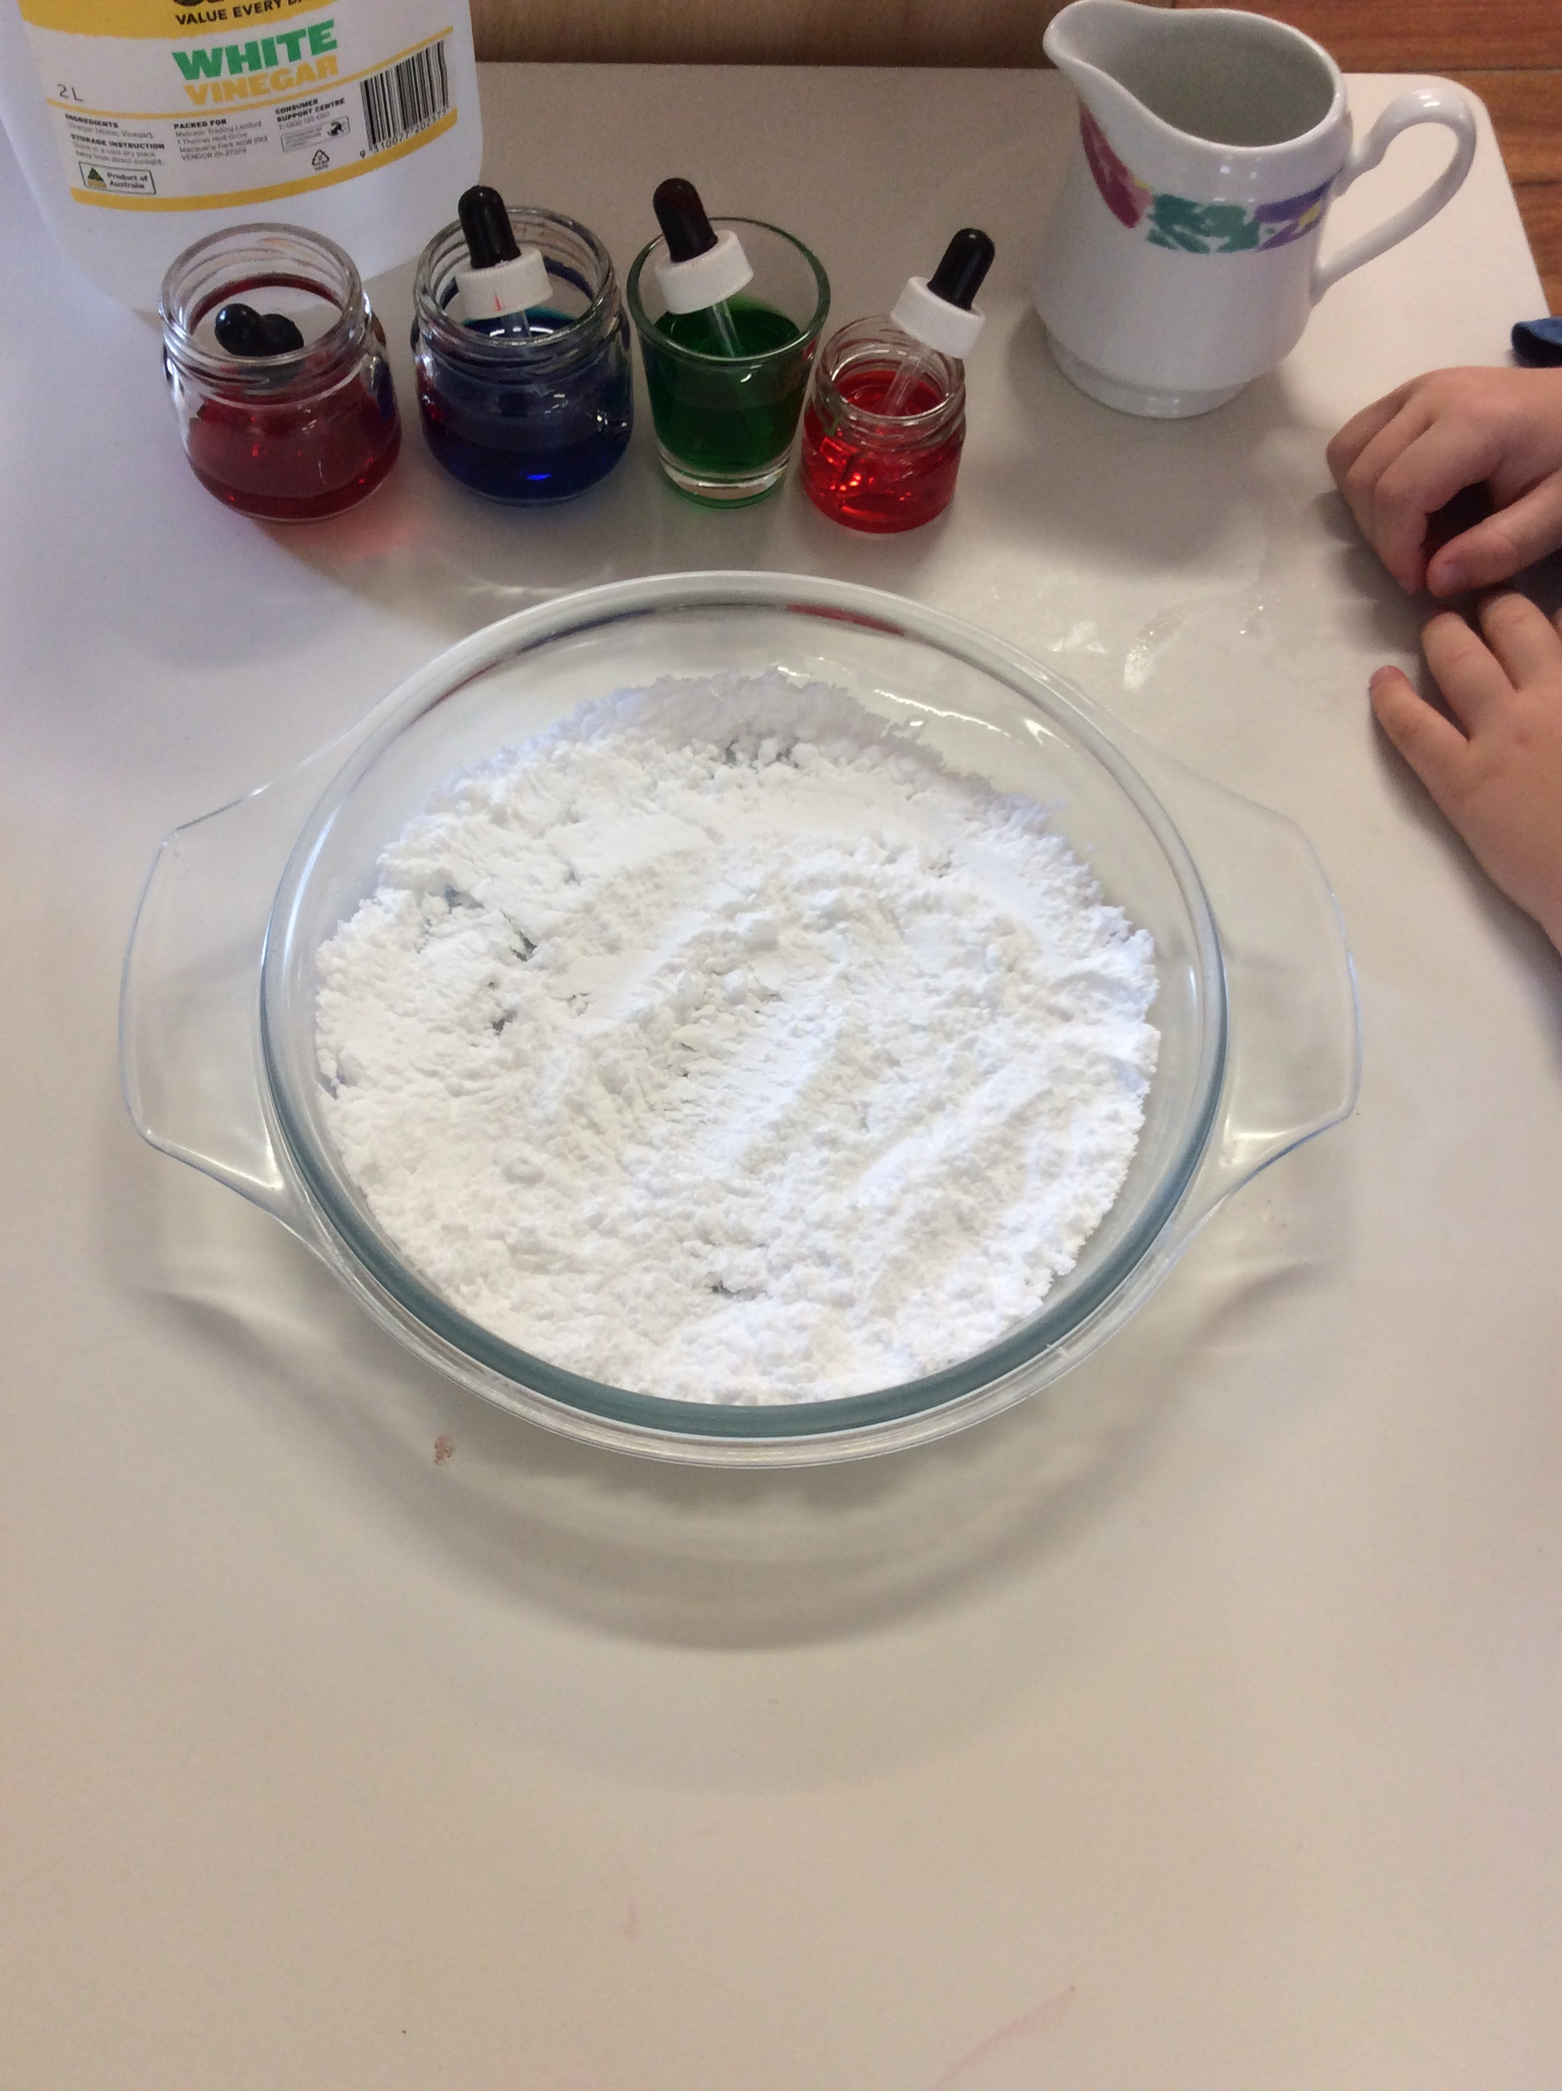
1. Scoop 6 big spoonful of baking soda into a bowl.

Slide 3
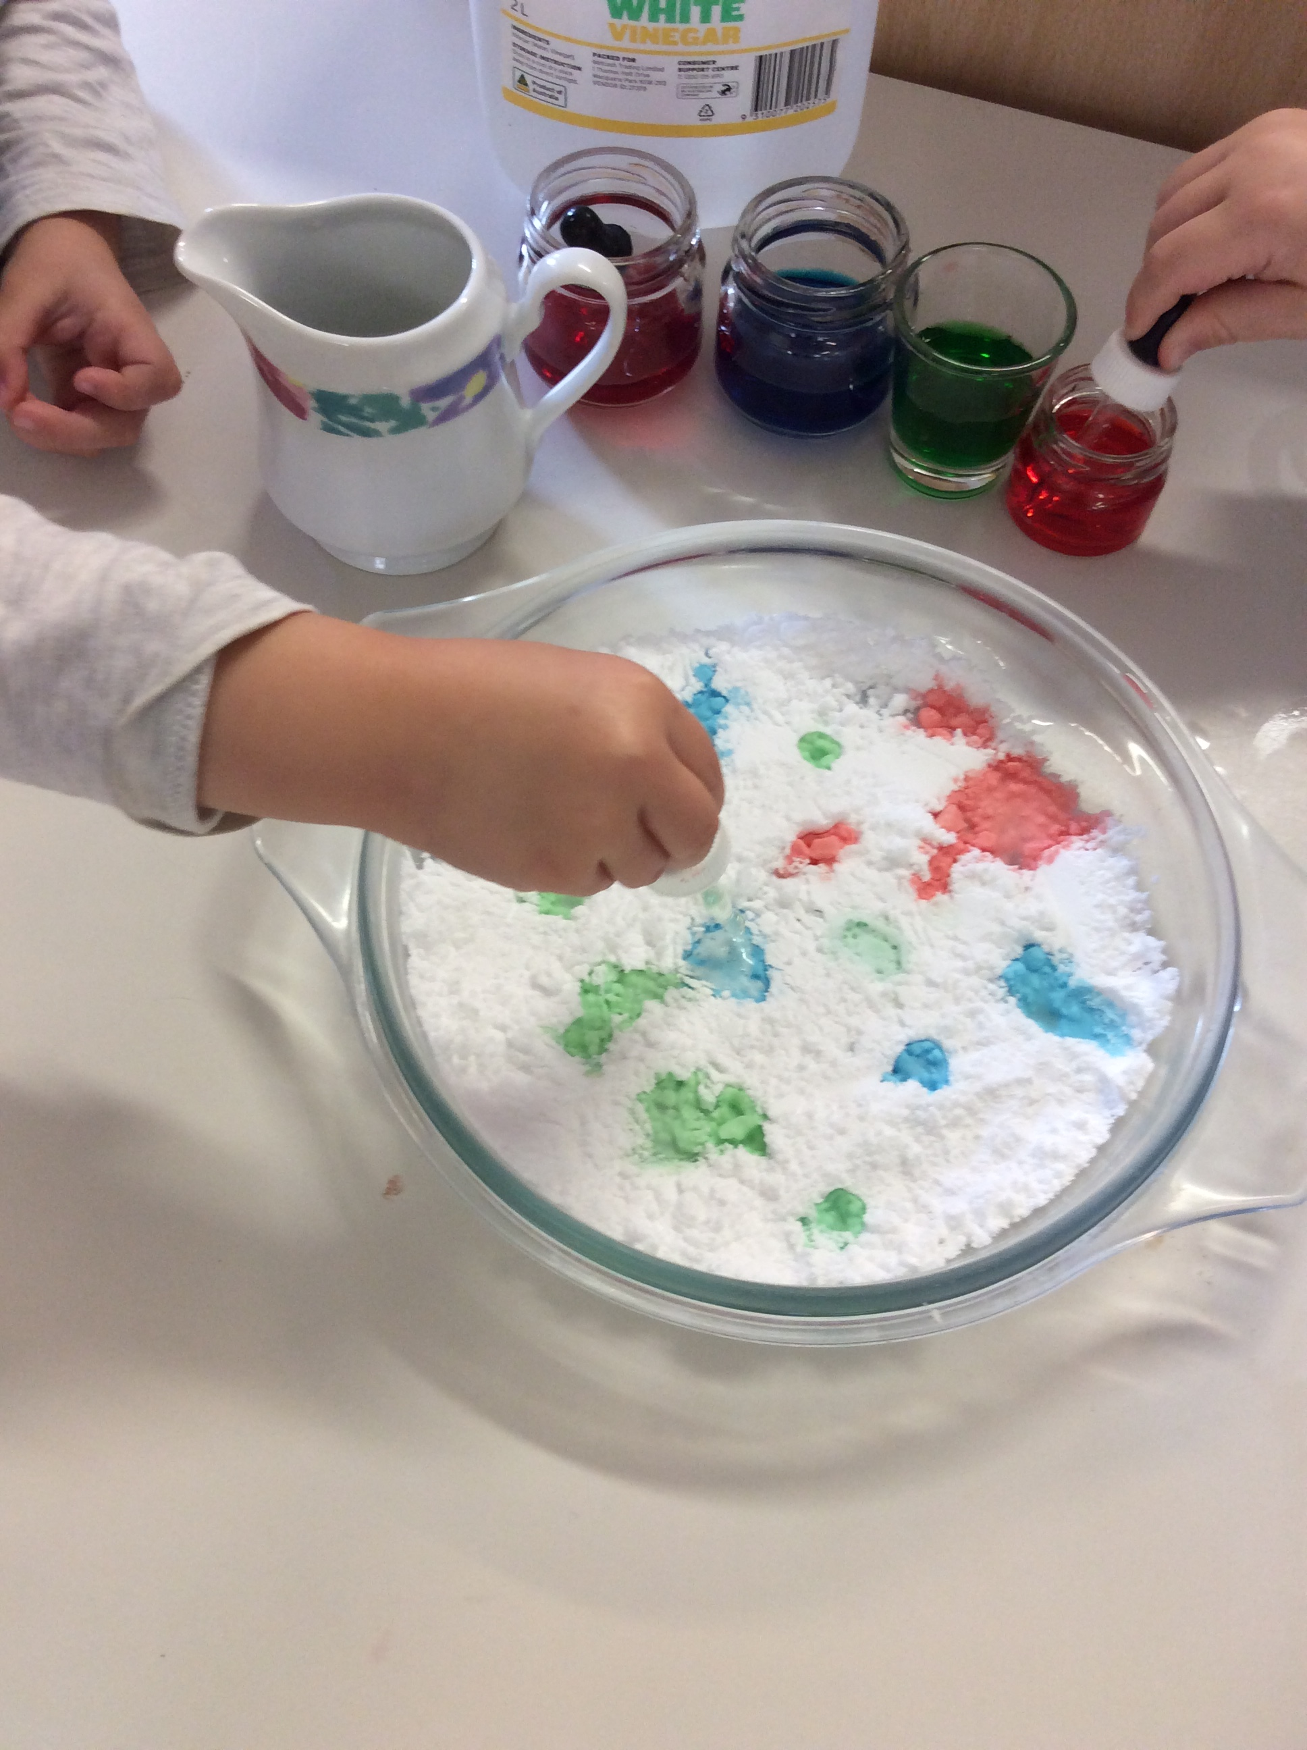
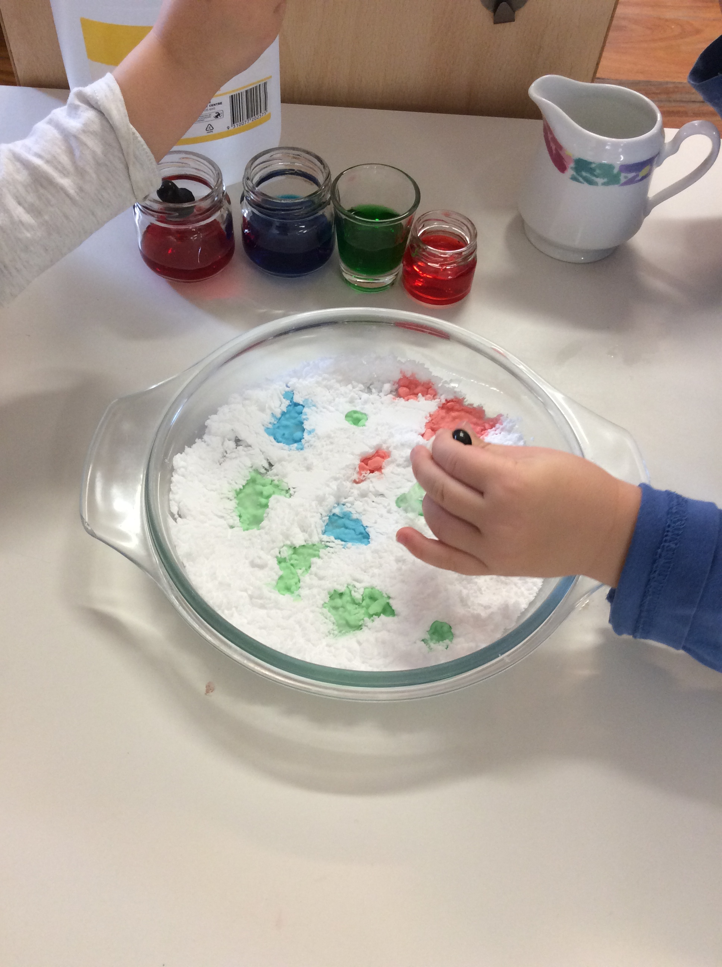
2.Add 2-3 drops or even more of food coloring.

Slide 4
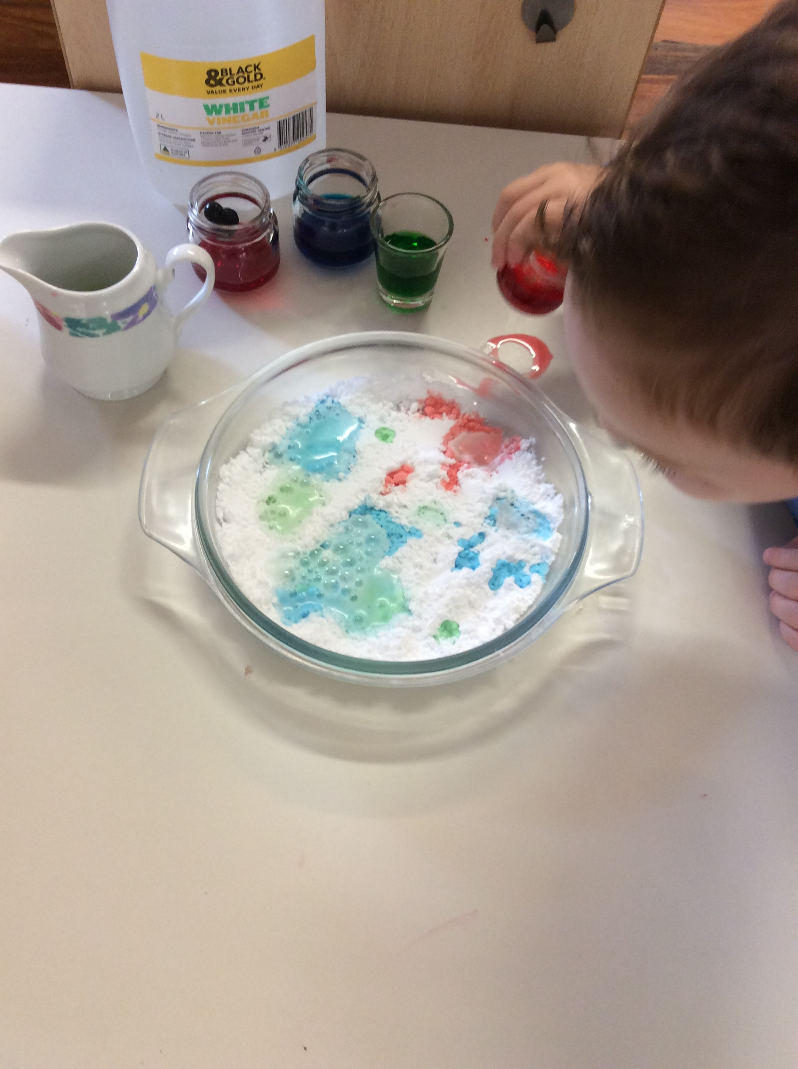
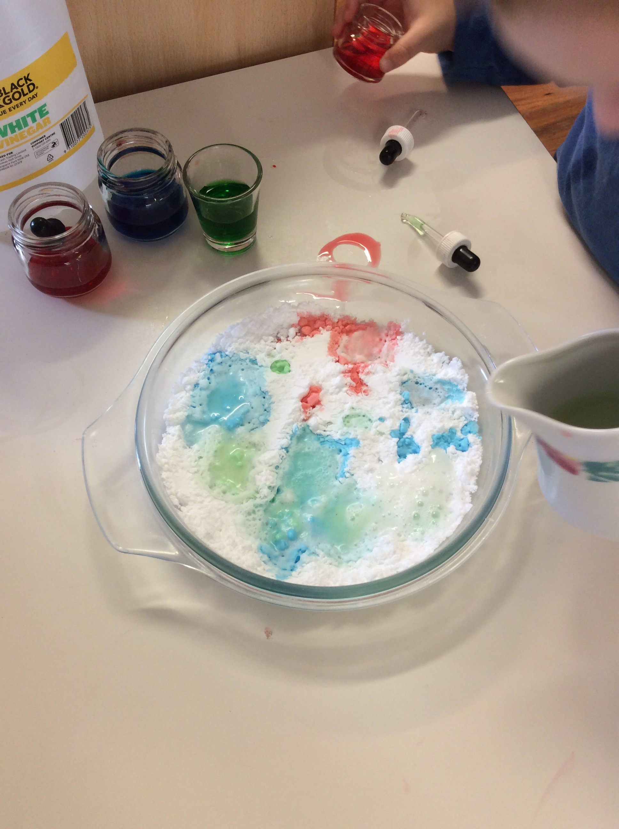
3.And now for the fun part, add a drop of vinegar onto the food coloring.

